Slide 1

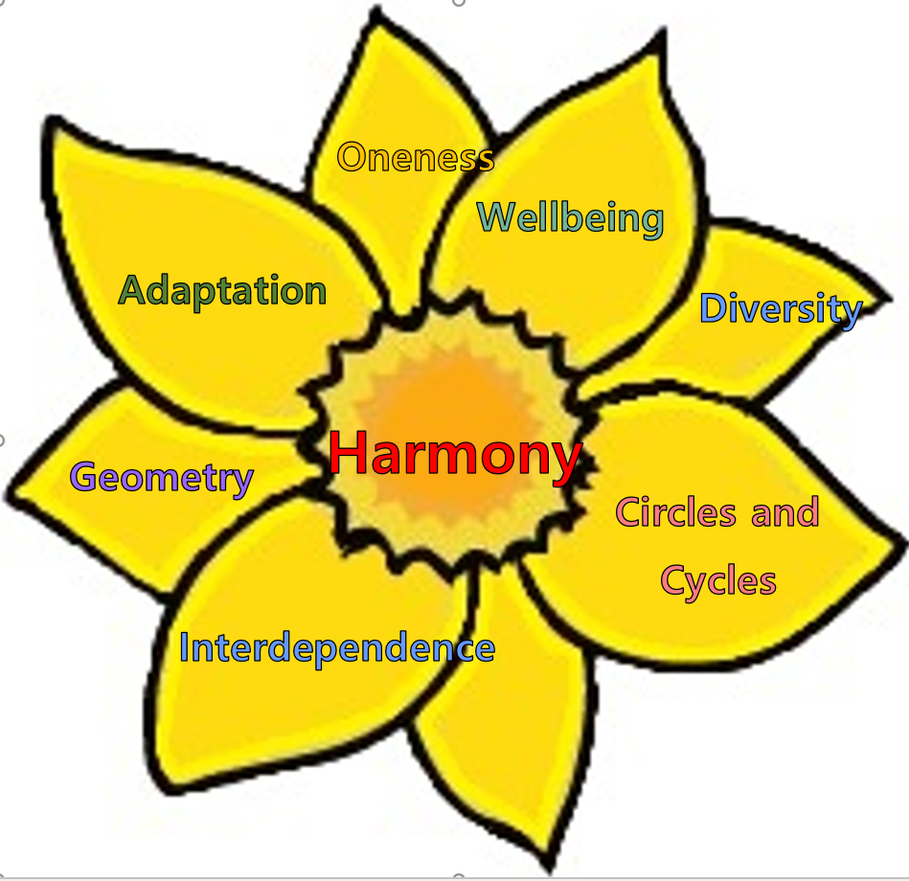
Welcome to South Farnborough Infants School

Slide 2
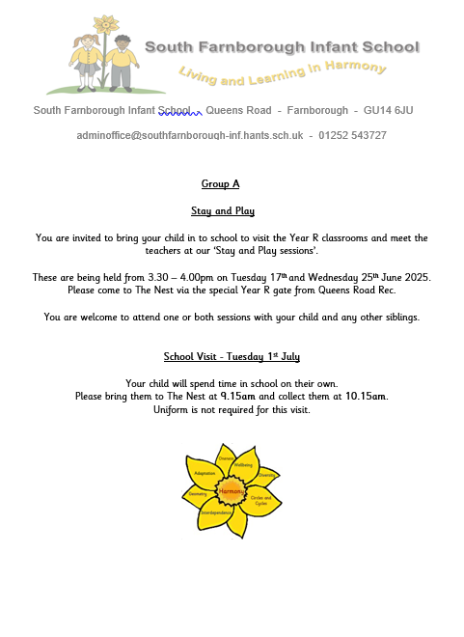
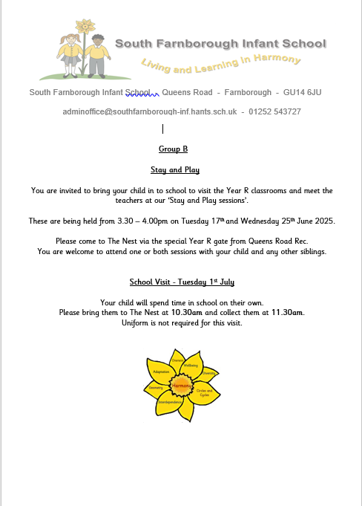
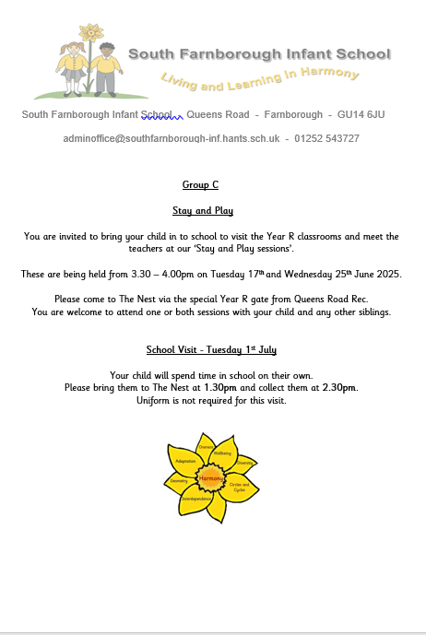
School Visits

Slide 3
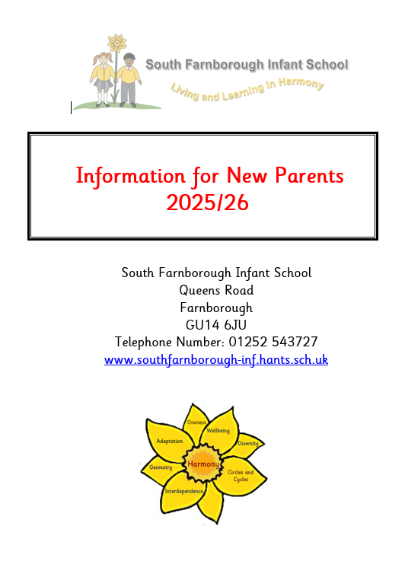
Information on:
Arriving/leaving school including timings, where to take or collect your child and late arrivals.
Parking around school.
Safeguarding
Absences
Medicine
Illness or accidents
Sun protection
Jewellery
Communication between home and school
News and information
Complaints
General data protection regulation
Policies
Food and drink including school dinners and packed lunches
School uniform
School Governors
Friends of SFIS
Parents in school
Website information

Slide 4
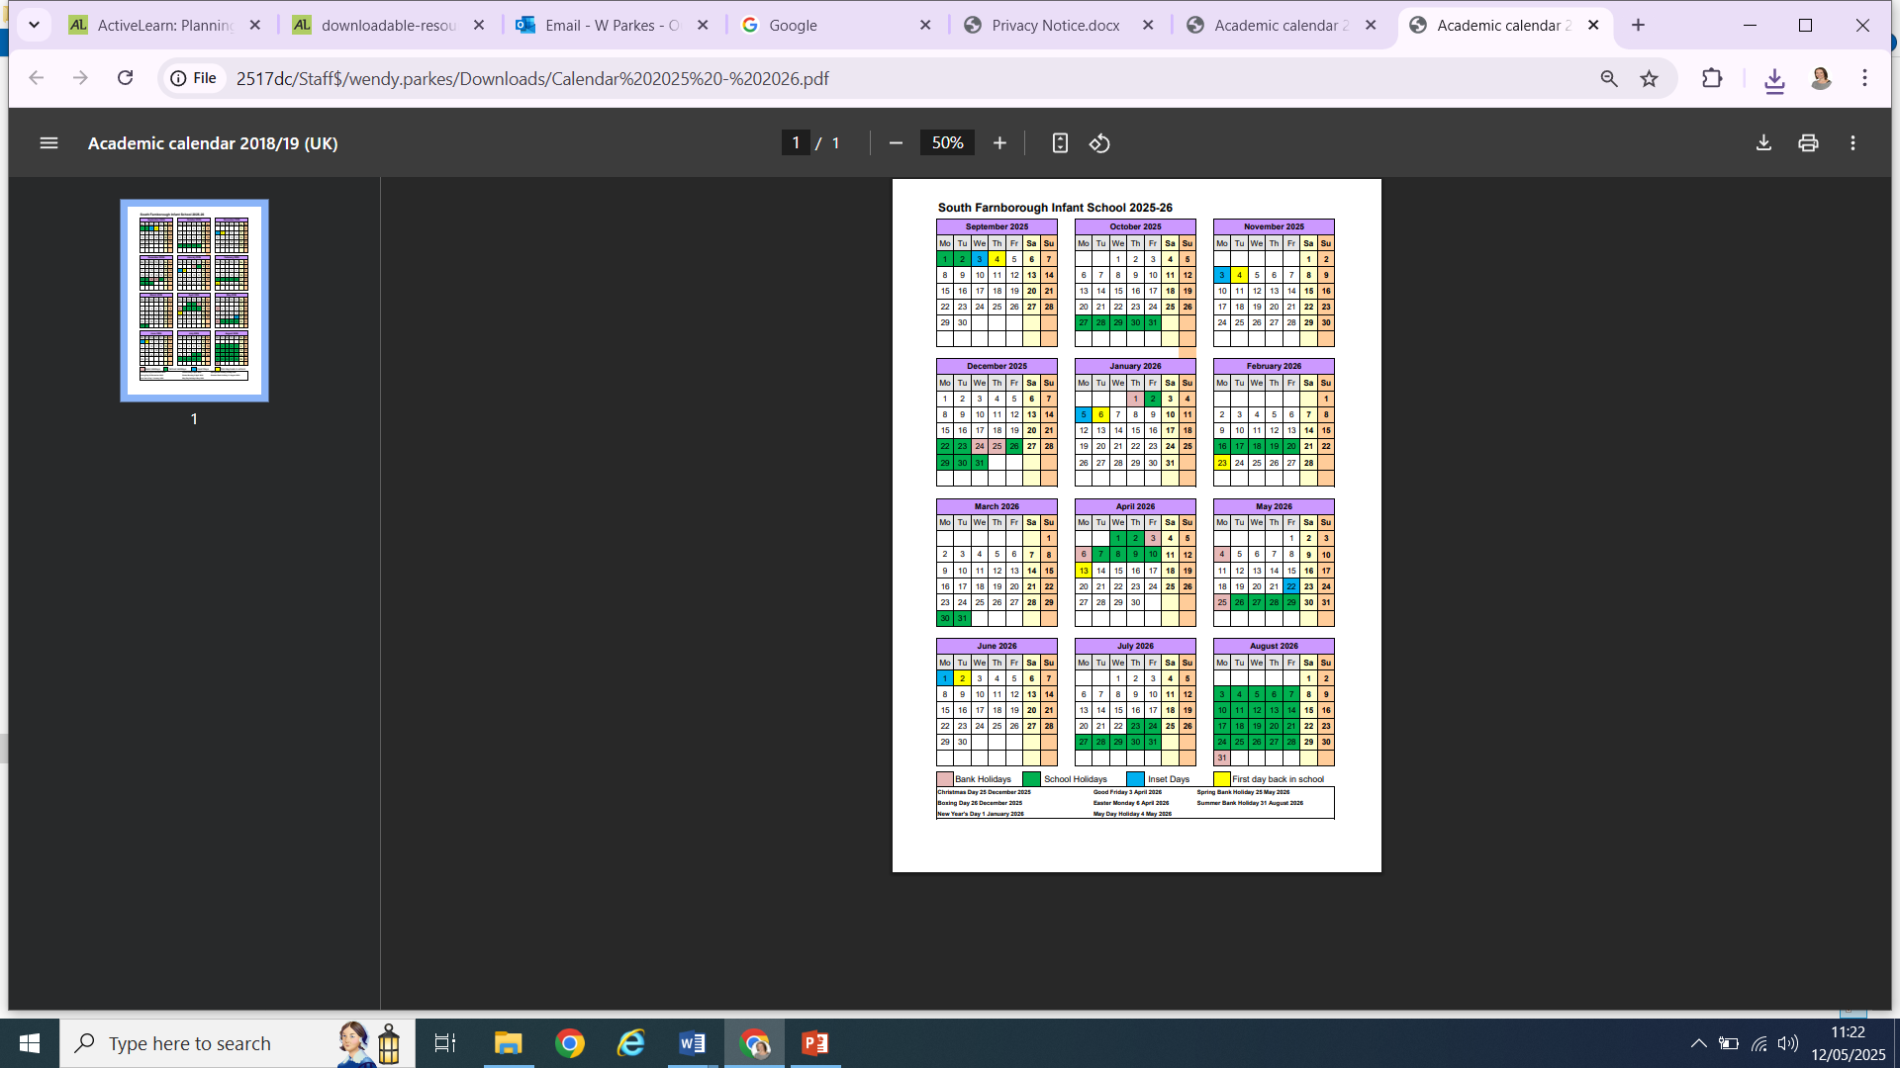
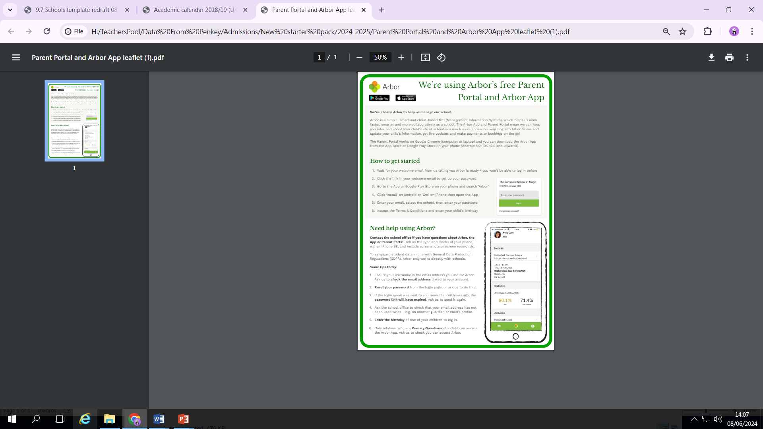
School Calendar
Arbor – parent portal

Slide 5
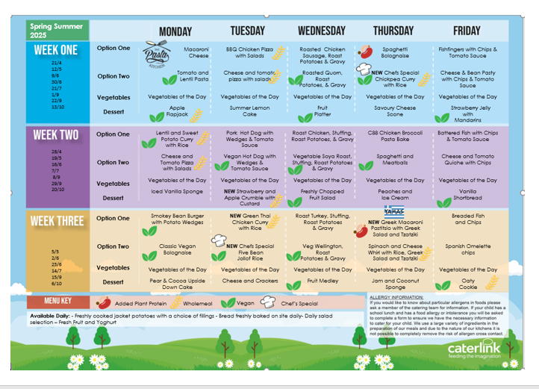
School Lunch Menu Example

Slide 6
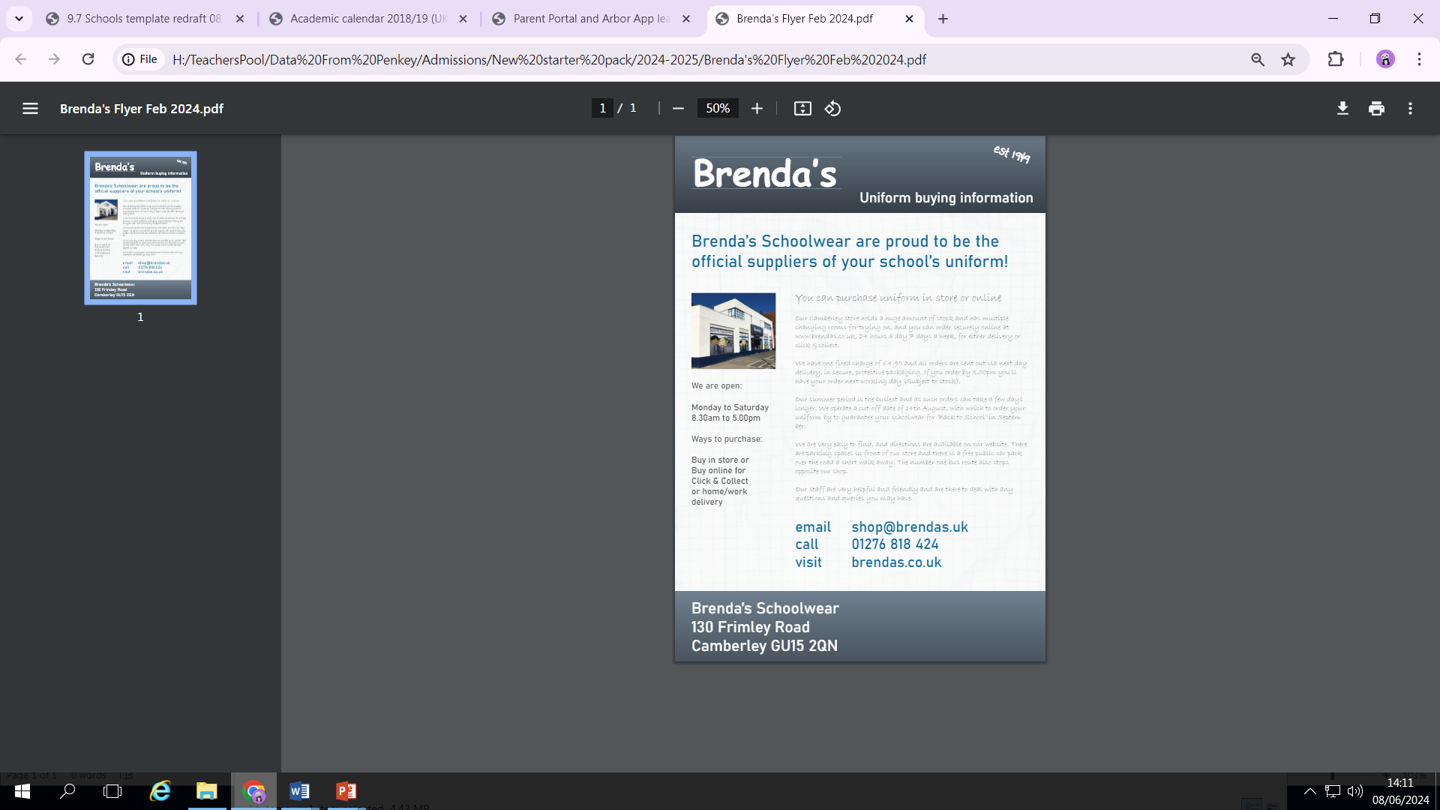
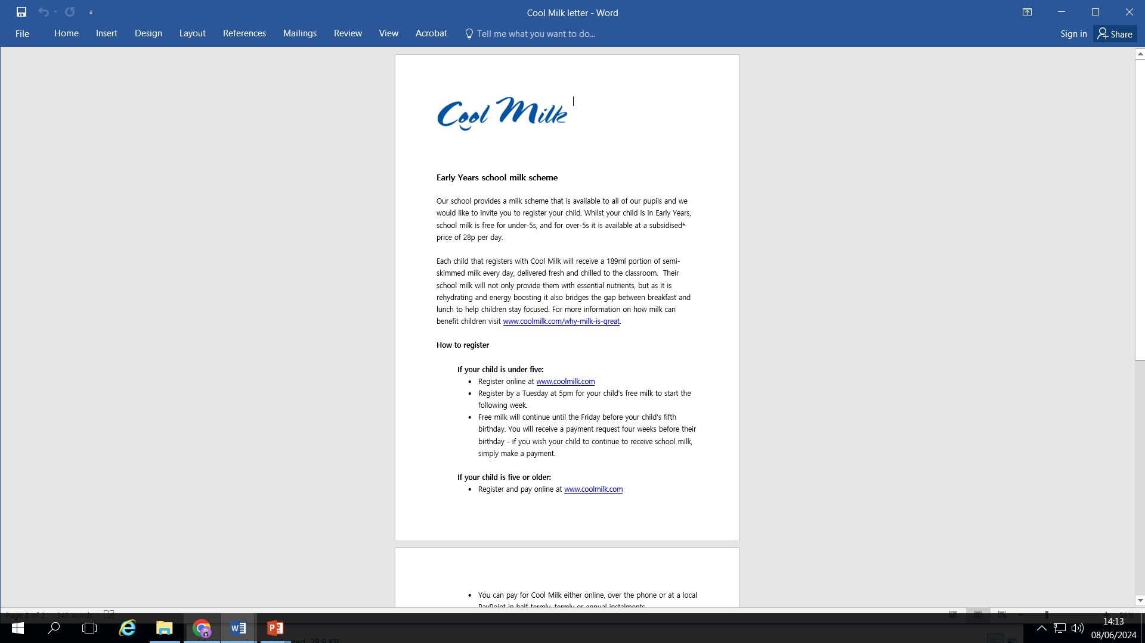


Slide 7
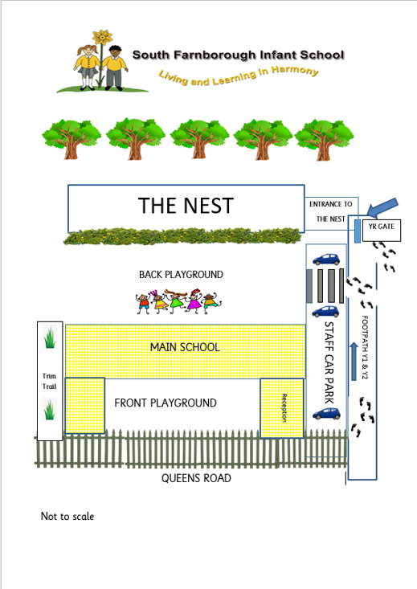
On each stay and play session/visit and when your child starts school, you will come through the park and in through the green Year R gate.
You will then walk up the car park and in through the black playground gates into the Year R outside area.
Then please make your way to the coloured bumpers (red, green or blue) for the visits and for the start of school.
Please collect your child from the same place each day.
Notes:
A

Slide 8

Our Unique Harmony Curriculum

Slide 9
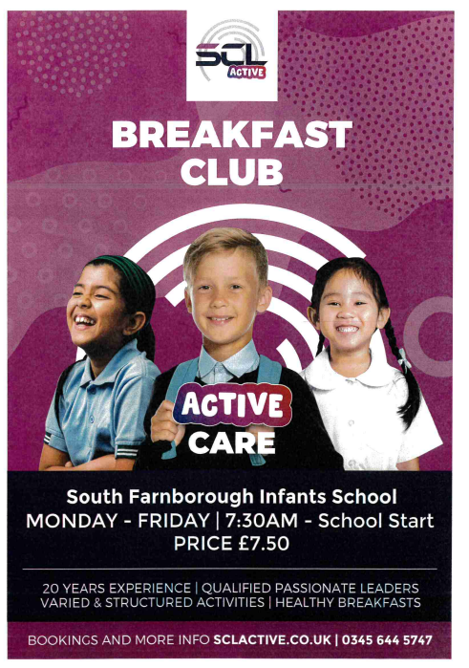
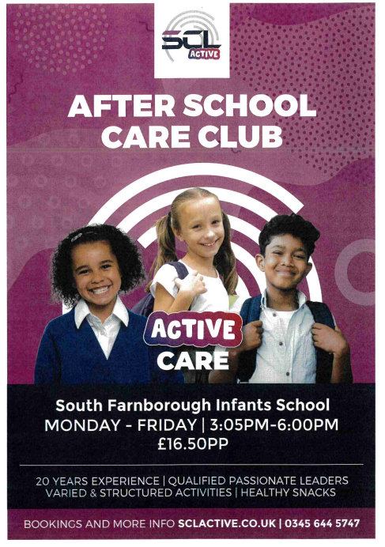
SCL – Before and after school Club

Slide 11
Home Visits
What's the point of teacher home visits?
The home visit is really all about getting to know your child a little, telling you a bit more about the school set-up – and giving you an opportunity to speak confidentially about your child’s needs and development.
What can I expect at a teacher home visit?
A teacher and learning support assistant will come along. Don't worry: it's very informal.
We will introduce ourselves to the child, have a friendly chat and have a little play.
Children are often keen to show us their toys and this can then be a great talking point for us when your child starts school. We can also use this to help to distract them a little if they ever become upset.
We will fill out a form with basic information about your child, such as the language they speak at home, their eating habits, if they have any allergies or medical conditions or anything else we need to be aware of. Also we will ask which toys and books they like.

Slide 12
Do you need to prepare for the teacher home visit?
The only preparation that we recommend is making sure your child knows what's going to be happening. Talk in a positive way to your child about a teacher from their school coming and maybe get them to choose a favourite toy to show, just so they have something to share.
One thing you don't need to do is make sure the house is neat and tidy!
We honestly aren’t there to look at how tidy your house is! We are happy to see played-with toys and we really don’t care if you have piles of ironing!
“We're just there to meet you and your child."

Slide 13
The First Weeks of School
Activities around the classroom, hub and outdoor areas
Time to play with the other children and to make new friends
A Circle time when we get together to chat and find out about each other
A snack time
A play time out in the Year R play area
Lunchtime in our main school hall
A story time or a Year R assembly

Slide 14
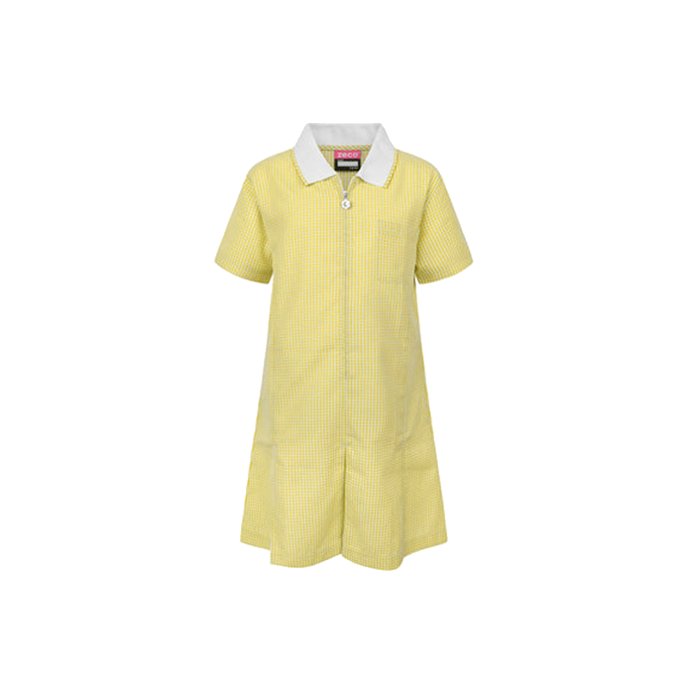

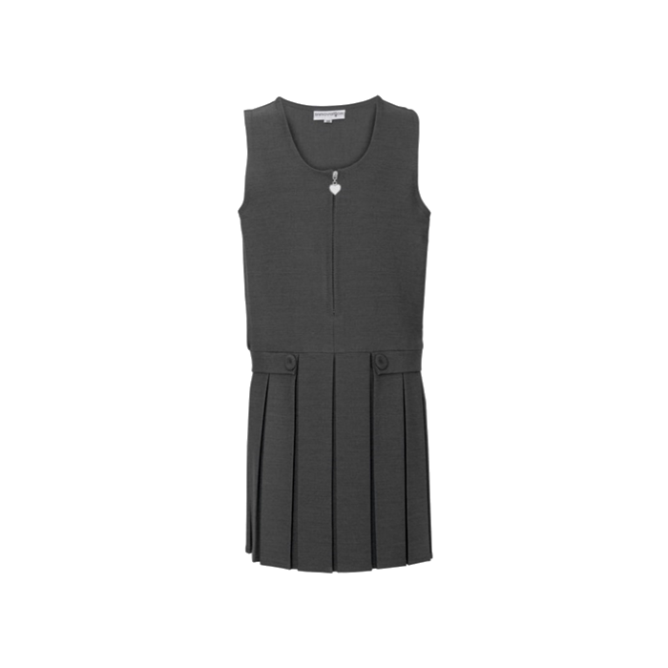


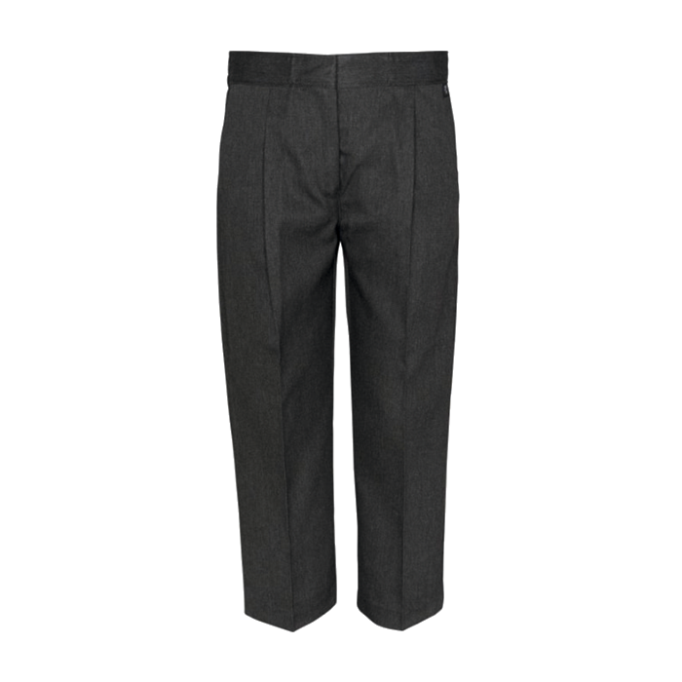
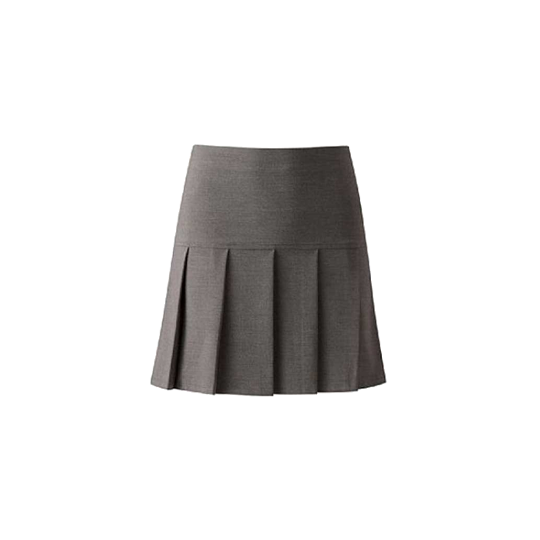
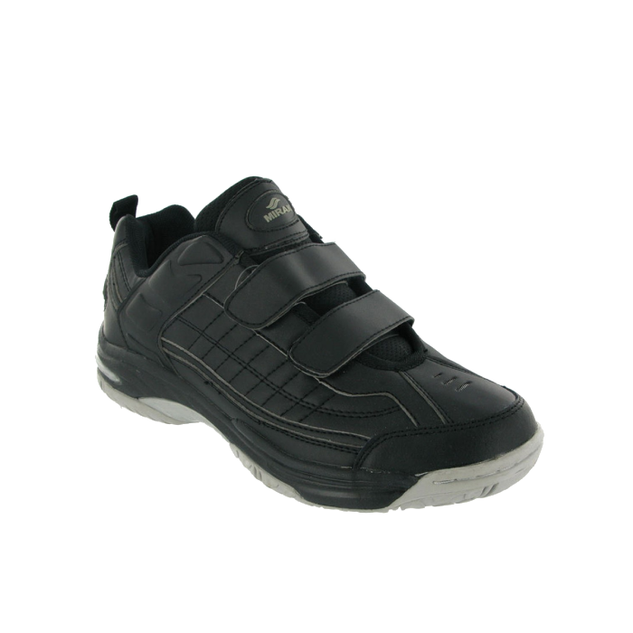
School Uniform
Notes:
School Uniform:
We expect children to be in the correct uniform which consists of a white polo shirt (with or without the school logo), grey trousers/skirt/pinafore or yellow sun dress in warm weather, a yellow cardigan or jumper, grey tights or socks and Velcro fastening black waterproof sensible trainers. We are always outside so trainers is a MUST as they are much more practical.
Once the children are in classes we would like you to bring in a pair of wellies which will be stored in school for the year.

Slide 15
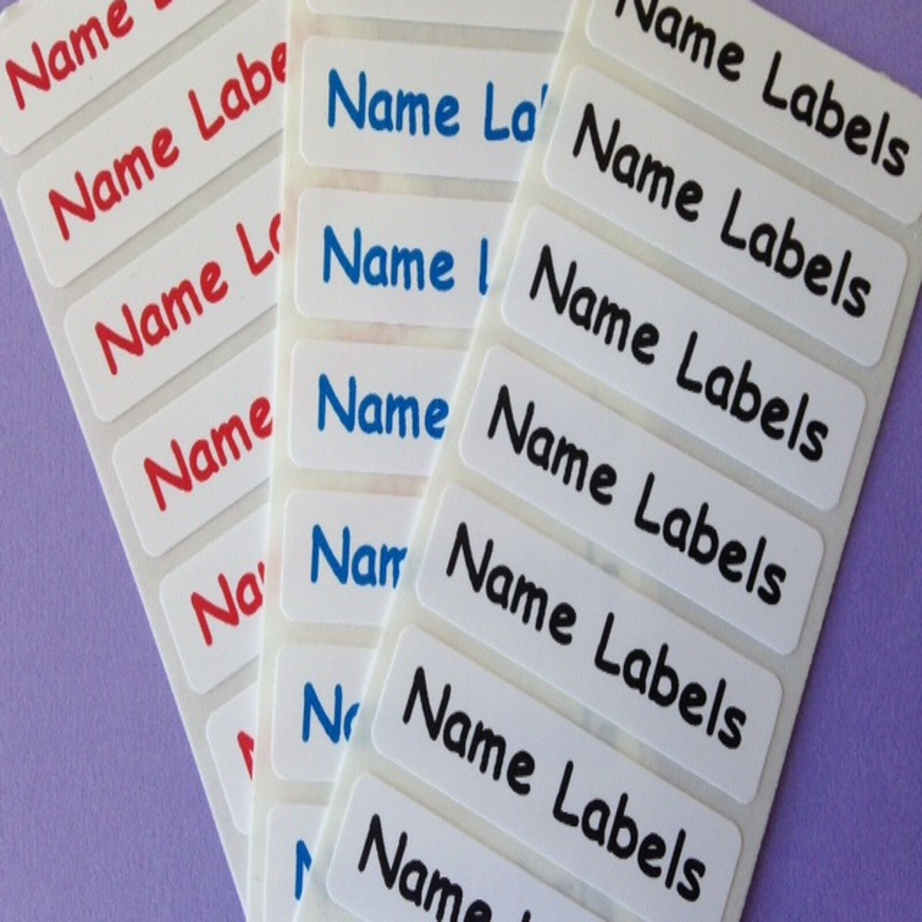
Please name everything!
Notes:
A plea from all of us: Please, please, please put the children’s names on everything they bring into school! We can read the children’s names even if they can’t!

Slide 16

Tapestry is award-winning software with tools to help educators work in partnership with families, document children's learning and development, and develop a child-centred approach to planning and assessment.
Each child will have their own online learning journal on Tapestry. This journal will enable us to follow your child's learning and development, and to plan experiences to help them to make progress. Through the journal we will share weekly 'observations' with you, which can be words, pictures and videos about your child's time here. You will also be able to use Tapestry to add pictures and videos of learning and experiences that happen at home. These will help us to get to know your child better - getting to know each child is at the heart of our good practice.
Please note that whilst home and school will be able to comment on observations, Tapestry is not a direct messaging service to staff, so please do continue to liaise with teachers in person or via the school office.
At the end of Reception, you’ll be able to download all of the photos and observations that have been uploaded over the year.
Notes:
Once the children are in a class they will spend the first few weeks in their own class groups, mixing with the children in the other EY classes during outside learning time and lunch playtime. We will also be getting together as a whole year group for assemblies once or twice a week. This helps them get to know each other and feel like a class and to find their way around their new environment and learn the new rules and routines.
All the adults in Early Years will be spending a lot of time observing the children, as well as playing with them, and recording what they do and how they do it, so that we can tailor their learning to the styles and activities that suit them best. We record what they do in their pink books (show book) and on Tapestry
Tapestry is award-winning software with tools to help educators work in partnership with families, document children's learning and development, and develop a child-centred approach to planning and assessment.
Each child will have their own online learning journal on Tapestry. This journal will enable us to follow your child's learning and development, and to plan experiences to help them to make progress. Through the journal we will share weekly 'observations' with you, which can be words, pictures and videos about your child's time here. You will also be able to use Tapestry to add pictures and videos of learning and experiences that happen at home. These will help us to get to know your child better - getting to know each child is at the heart of our good practice.
Please note that whilst home and school will be able to comment on observations, Tapestry is not a direct messaging service to staff, so please do continue to liaise with teachers in person or via the school office.
At the end of Reception, you’ll be able to download all of the photos and observations that have been uploaded over the year.

Slide 17

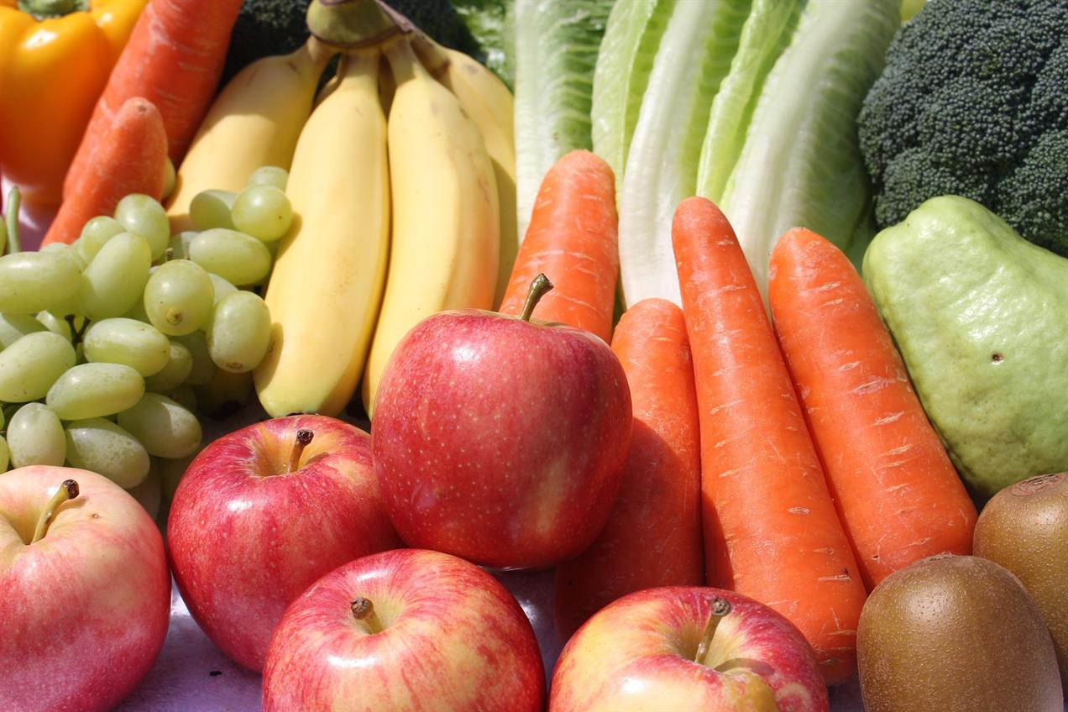
Notes:
South Farnborough Infants is officially a “Healthy school” and we are part of the government funded free fruit/vegetable scheme.
Therefore you will not need to provide a snack each day.

Slide 18
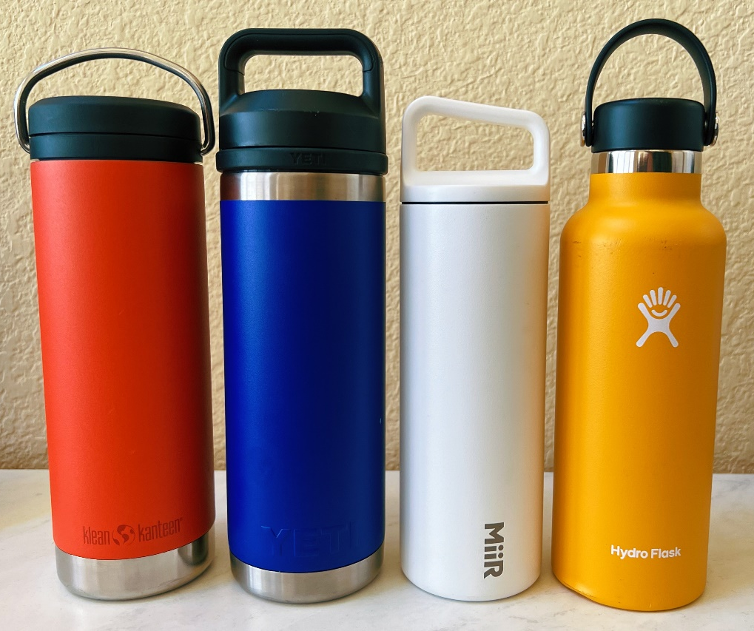
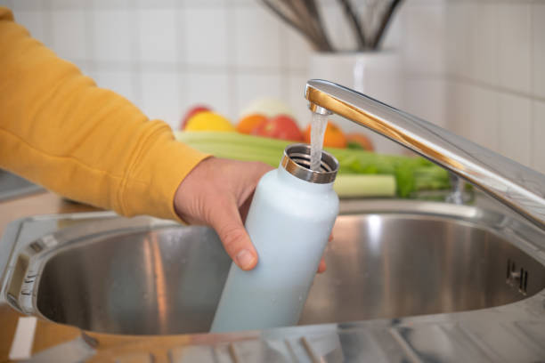
Water only please!
Notes:
The children will only need to bring a drink bottle containing only water every day.

Slide 19

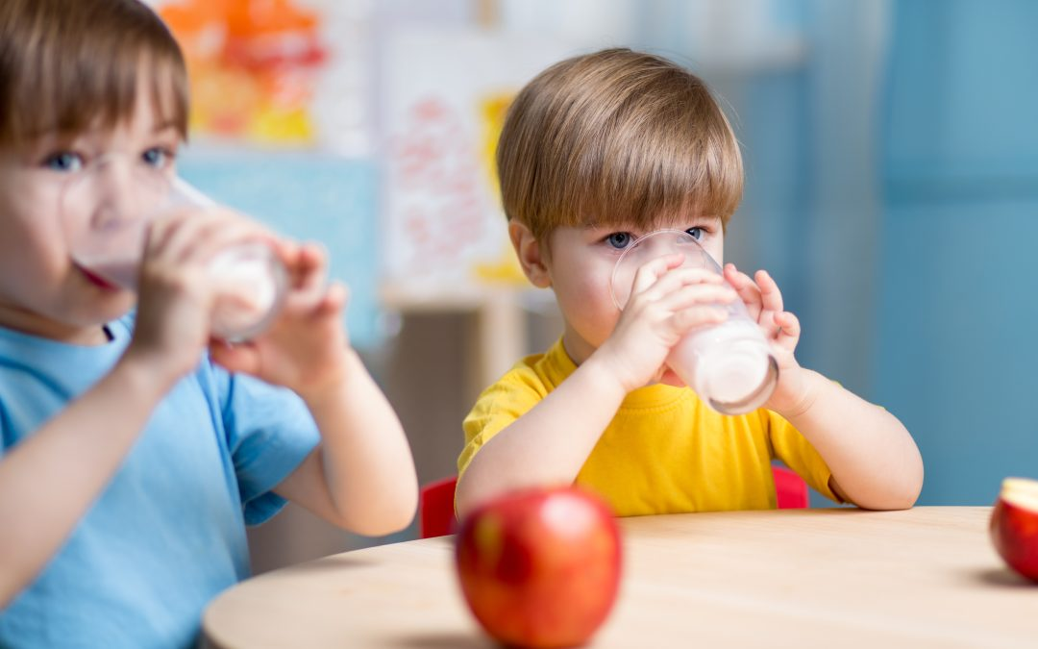
Notes:
The children can also have milk with their snack if they would like it. You need to register if you would like your child to have milk through the cool milk website. There is information about this in your yellow folders.
We offer this free until they are five. Once they are 5, you can pay for your child to continue to have milk whilst they are in Early Years. It is available at a subsidised price of 28p per day.
All the children are entitled to school dinners for free and we do hope you will be taking up this very generous offer – you don’t get much in life for free, but a tasty, nutritious two-course meal is definitely worth having!
Caterlink provide the school lunches and there is a copy of the menu included in your information pack. If your child has a special diet, this can be accommodated. You need to choose your child’s dinner every day via the Arbor app in advance before the day. You can order for a whole week at a time to make it easier.

Slide 20
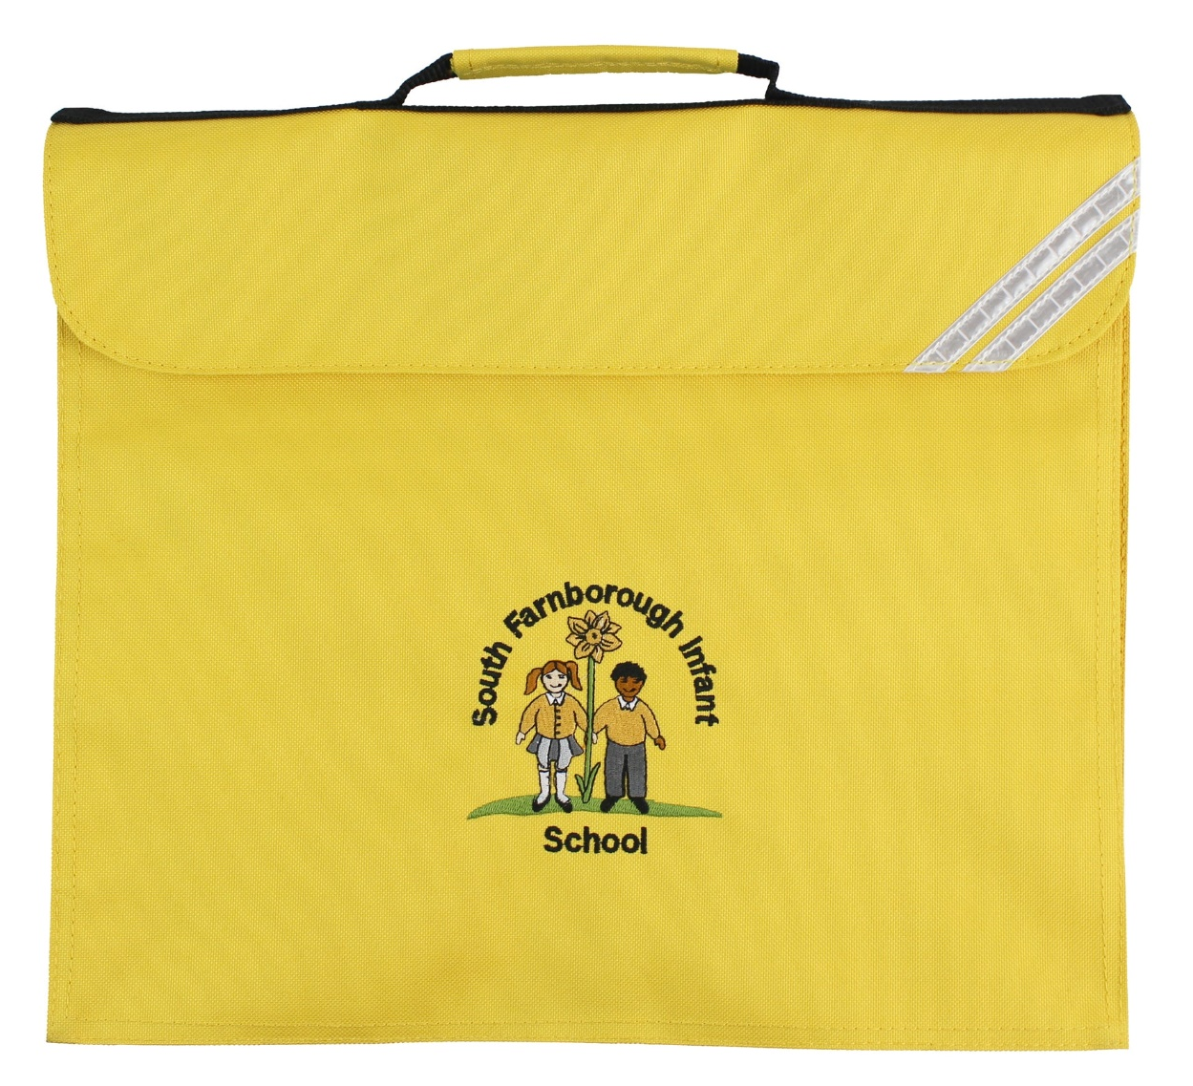
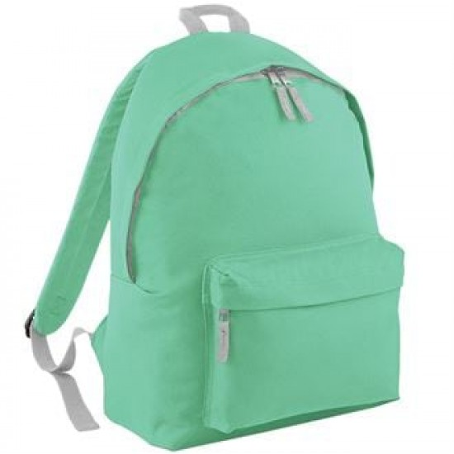
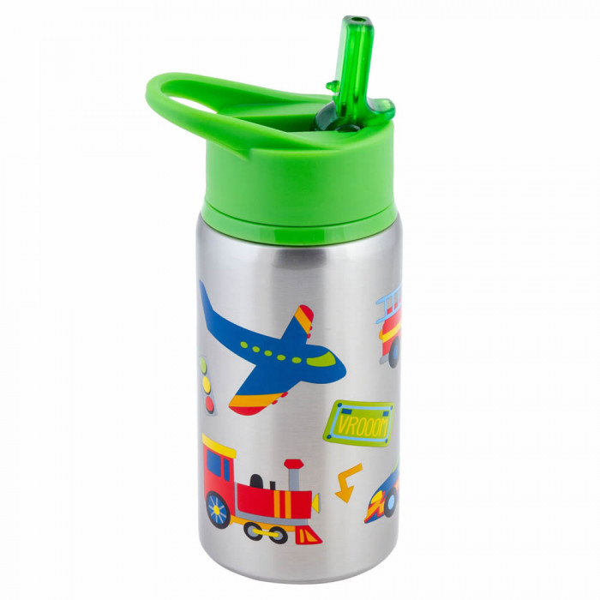


Notes:
Please send the yellow book bag in to school every day, Please can we ask that you put a sun hat and a lightweight waterproof coat in their book bag as we do go out to play in all weathers!
Please do not bring a rucksack as we are limited on space and only have room for book bags!
Your child will be bringing home a library book and later on a reading book. We will be having an information evening about phonics, reading and maths in October.
Your child will need to bring a water bottle and book bag every day from the first day of school.
Please don’t put water bottles inside the book bags – if they leak then they ruin any books inside.

Slide 21

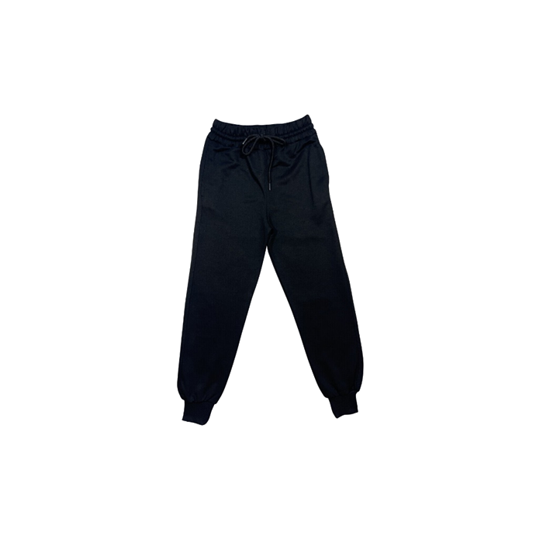


PE Kit
Notes:
Once the children are settled into school, we will be doing P.E. and everyone will need a P.E. kit. This is a white t-shirt and a pair of black shorts, leggings or jogging bottoms depending on the time of year and the weather. They will also need to wear their black trainers and their school jumper/cardigan.
The children will need to come to school wearing their kit on PE days
No jewellery please except for religious or medical reasons.
We will let you know nearer the time which days this will be.

Slide 22
How to help your child prepare for school?
Self help skills:
Going to the toilet independently, wiping bottoms and washing hands
Putting a jumper on and taking it off
Doing up and undoing buttons
Putting on their coat and zipping it up
Putting on a pair of gloves
Using a knife and fork
Wiping their nose
Recognising their own name written down
These skills will help them to settle quickly into school life. We won’t let them flounder if they can’t do these things but the sooner they can do these things, the quicker they can start on learning all sorts of other things!

Slide 23
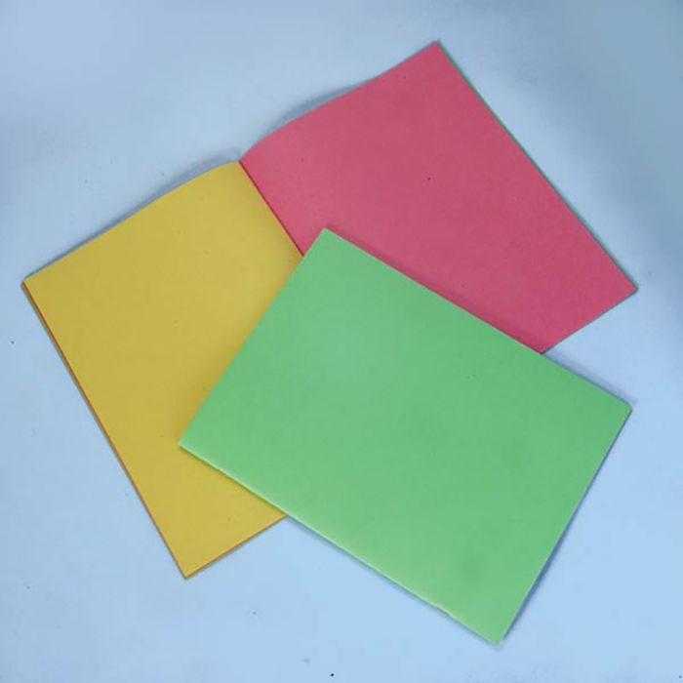
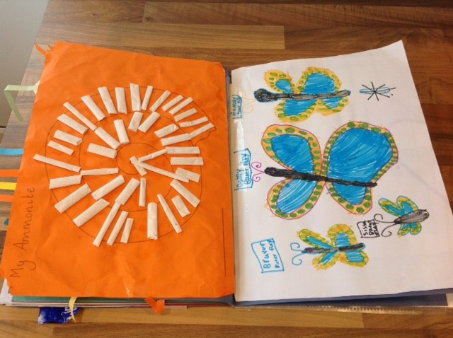
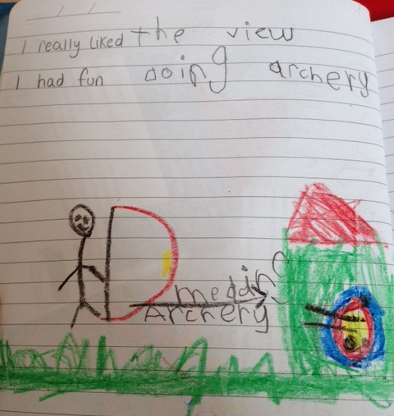
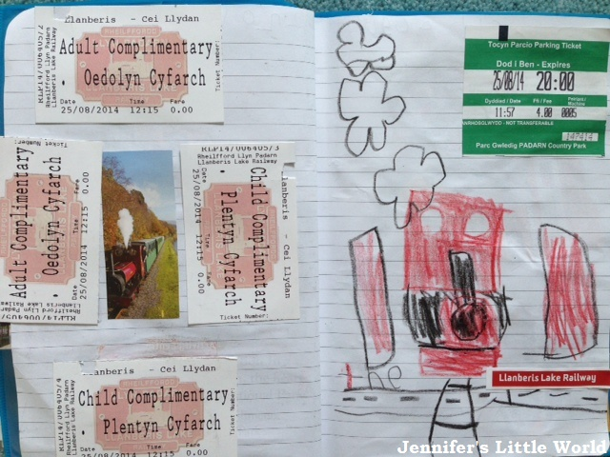
Year R scrap books
These are for your child to record anything they do each school holiday. The first page is for the children to give information about themselves and their family e.g brothers, sisters, pets, favourite colour, and anything else they would like to tell us about. In the rest of the book, they can stick things from their holidays starting with this summer before they start school. They can include tickets, photos, leaflets of places visited, drawings etc. Each school holiday they will bring their scrap book home so they can add to it.
Notes:
Before we finish I need to show you our Early Years scrap books, please take one with you when you leave. These are for your child to record anything they do each school holiday. The first page is for the children to give information about themselves and their family e.g brothers, sisters, pets, favourite colour and anything else they would like to tell us about. In the rest of the book they can stick things from their holidays starting with this summer before they start school. They can include tickets, photos, leaflets of places visited, drawings etc. Each school holiday they will bring their scrap book home so they can add to it.

Slide 24
School Website
Please visit our school website and subscribe to the school calendar, this will keep you up to date with all of the key things happening at school.
The website also has information on:
Our Harmony Curriculum
Our current staff members
Governors
Policies
Safeguarding
Online safety
Special Educational needs
Performance data
Wraparound care
Phonics
Attendance
Newsletters
Term dates
Parent support advisor information
Year Group information
Fundraising
Friends of SFIS
Notes:
School website: Please visit our school website and subscribe to the school calendar, this will keep you up to date with all of the key things happening at school.

Slide 25

Birthdays!
We always celebrate the children’s birthdays in school. The class will sing to your child on their special day and we will ask them about their celebrations. Children can also celebrate by wearing their own clothes on their birthday or the nearest school day to it. As we are a healthy school, please do not bring in any sweets or cakes to give out on your child’s birthday, you can do any celebrations with their friends outside of school.
Notes:
Birthdays:
We always celebrate the children’s birthdays in school. The class will sing to your child on their special day and we will ask them about their celebrations. Children can also celebrate by wearing their own clothes on their birthday or the nearest school day to it. As we are a healthy school, please do not bring in any sweets or cakes to give out on your child’s birthday, you can do any celebrations with their friends outside of school.

Slide 26
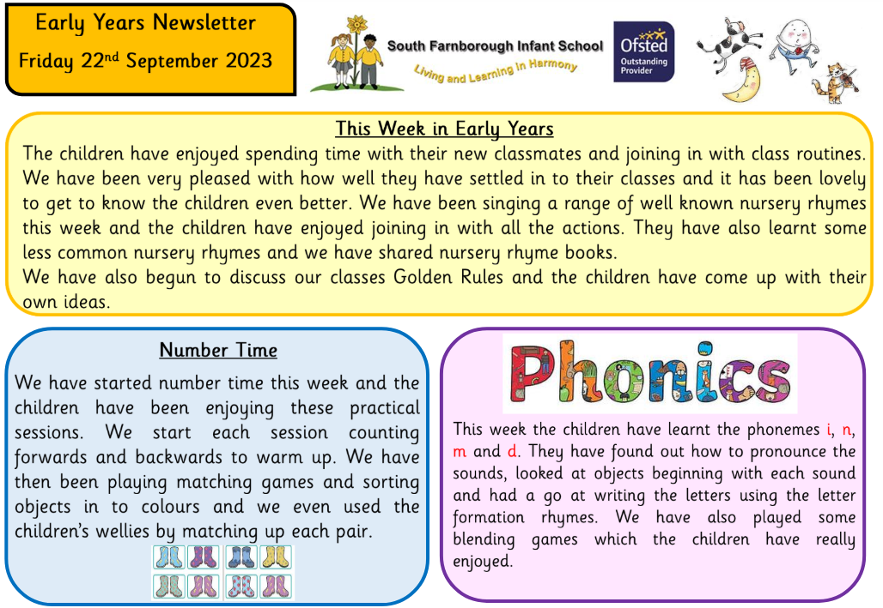
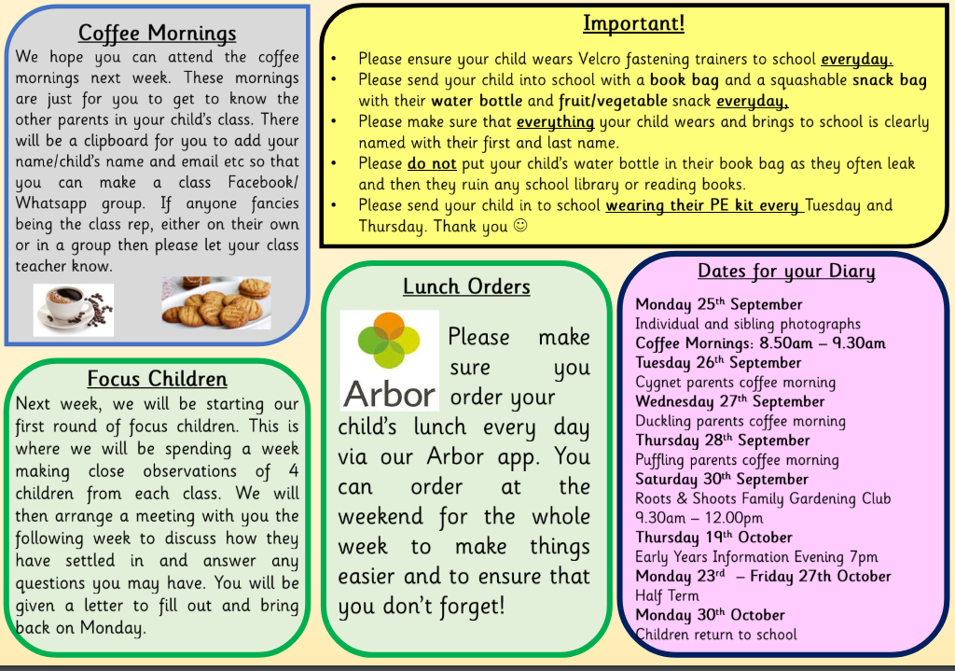
Newsletters
Lastly I need to tell you about our Early Years Newsletter which will be emailed to you half termly. This will give you information about what the children will be learning in school for that half term. It will also tell you anything important and if there are any dates coming up. The second page will give you some ideas for how you can help your child with their learning at home, based on what they have been doing in school.

Slide 27


Thank you for coming tonight.
We hope you are now armed with all the information you need about your child starting school at South Farnborough Infant School.
Any questions?

