Slide 1
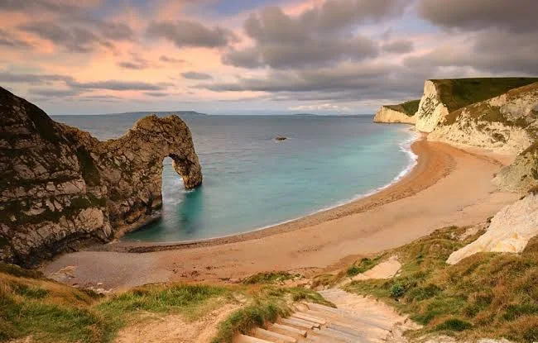
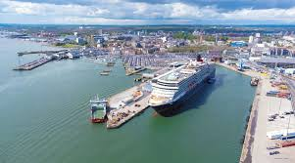
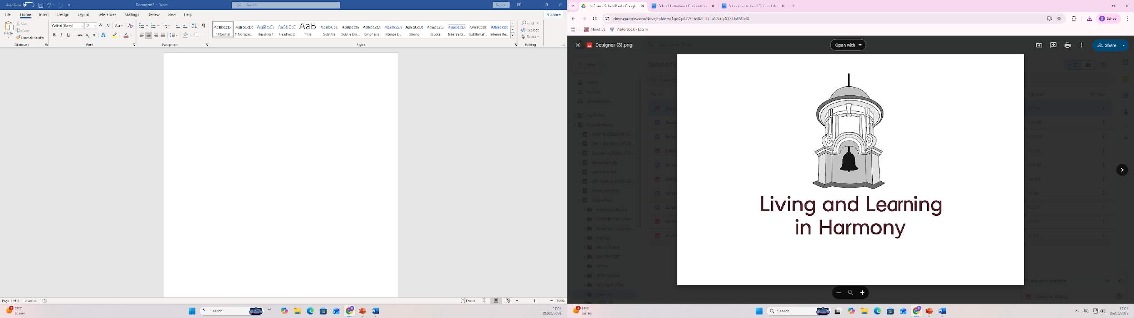
Coasts
This term, we will be learning all about the United Kingdom’s coasts and why they are so important. It will also be a chance to discuss climate change ​
and the effect this is having on our beautiful coastline. We will continue to use maps and pictures, photographs and aerial views of our varied coastline .
If you have any resources that would be useful to our learning , please contact your class teacher.
Geography
Dear Parents, ​
A very big thank you to all parents who got involved with World Book Day, either by creating fabulous costumes or by joining your children to share stories. The children were amazing and everybody enjoyed promoting the love of reading.
As we enter the final term at South Farnborough Infant school, we look at how far the children have come and also fine tune their preparations ready for their transition to Junior school.
Please support your child at home by reading every day. This could be their reading book, school library book or a book from home. The more exposure to different texts, the better!
Thank you for your ongoing support
The Year 2 team.

Slide 2

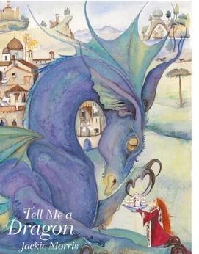



English
We will be focusing on the texts ‘Tidy’ and the book ’The Lion and the Mouse.’Children will be continuing to gather new vocabulary, work on grammar and use these skills to enhance their own writing.
Maths
Our topics this term are
Length and height .
Capacity mass and temperature.
Fractions
Spellings
These words are quite tricky. Please practice them at home .
Coast
Shore
Harbour
people
Geography vocabulary
Beach: A shore covered in sand or pebbles.
Cliff: A high, steep, vertical rock face.
Coastline: The outline or shape of the coast.
Sea/Ocean: Large bodies of saltwater.
Human Features Things in our environment that have been built or made by people, rather than being natural.
Physical Features natural, non-man-made elements of the landscape that would exist without human presence.
Website
Please check out our website and in particular the school news section. This showcases the learning we have been doing and links to activities for different subjects
https://www.southfarnborough-inf.hants.sch.uk/school-news

Slide 3
Optional Learning Beyond the Classroom
sandy, rocky, rugged, steep, barren, serene, sunny, windy, and picturesque.
harbour promenade shingle pier
Physical and human features
Support your child at home by learning the meaning to some or all of these words.
If you choose to do any of these activities we would love for you to bring in photos to share with your class.
Creative Activities | Junk model boat Create seashell art Underwater scene using paints pastels etc Build sand castle and rock structures
Things to do | Visit the local coast Go Rockpooling Visit an aquarium https://www.bluereefaquarium.co.uk/portsmouth/#:~:text=Home%20%2D%20Blue%20Reef%20Aquarium%20Portsmouth,Welcome%20To Build sandcastles
Research | Visit the library and find some non fiction books about coasts
Coast
Beach
Cliff
Dune
Harbour
ocean
Subject Specific words
Describing Words
Key Words
Words to help with my learning

