Slide 1
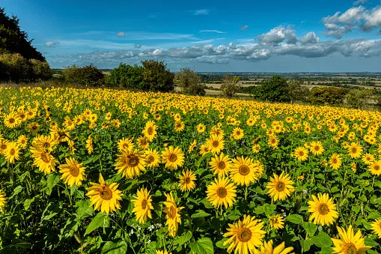






Reception Newsletter
Summer 1
Reception News
Summer 1 Topics
Children Around The World:
Harmony Principle - Diversity
Down on the Farm:
Harmony Principle - Interdependence
RE – Budha and Stories:
Wow we are in the summer term already! It seems like only yesterday that the children were starting in Reception!
We are really excited to see some sunshine and to get stuck into our exciting topics this term.
Please ensure that your child has a lightweight waterproof jacket at school everyday.
Also when the weather warms up, please can you send your child to school wearing a high-factor all-day sun cream and a named sun hat to protect them. Thank you
We start this term with learning about different countries from around the world. We will learn how to say hello in different languages, learn about life in other countries and we will compare their lives with our life in the UK. Celebration.
We will then move on to looking at farms including the animals which live on a farm and the jobs which farmers do. This links closely with our trip to wellington country park where we get to visit a real farm.
Phonics and Number Time
In phonics this term we will be focusing on Phase 4 which includes words with short vowels CVCC, CVCC CCVC, CCVCC, CCCVC, CCCVCC, longer words, compound words and root words ending in: –ing, –ed /t/, –ed /id/ /ed/ –est. We will also be learning our last tricky words: said, so, have, like, some, come, love, do, were, here, little, says, there, when, what, one, out, and today.
In Number Time this term we will continue to follow Power Maths and cover topics such as counting on and back linked to addition and subtraction, numbers to 20, doubling, halving and sharing, odd and even numbers.
We will finish this half term with our RE topic where we look at our school focused religion of Buddhism and talk about special Buddha stories.

Slide 2
Optional Learning Beyond the Classroom
Support your child at home by learning the meaning to some or all of these words.
Creative Activities | Our topics this term are Children Around the World and Down on the Farm. Below are some suggestions of things you could try at home to support your child’s learning Children Around the World As a family explore and try different foods from around the world. Down on the Farm Draw pictures of different farm animals and label them.
Things to do | Children Around the World Did you or any other family member grow up in another country? Talk to your child about your experiences or support your child in talking to other family members to find out what life is like and school is like in another country. There may be photos or artefacts your child can look at (if you are happy for these to be brought into school we can support your child in sharing these with the class). Down on the Farm Watch episodes of ‘Down on the Farm’ found on CBeebies with your child. Find out about the different jobs that take place on a farm. Explore adults and their babies ensuring you child knows the names for different animals.
Role Play | Act out some of the jobs that need to be done on the farm. For example - feed the chickens, milk the cow, clean the barn etc.
Children Around the World - World, map, globe, names of some countries, language including saying hello in a variety of ways, traditional clothes,
Down on the Farm -
Sheep, lamb, pig, piglet, ducks, ducklings, tractor, farmer, farm, hay bales, chickens, donkey, cow, calf, horse, foal, goat, kid, stable, barn, farmyard, coup, cockerel.
Other ways to support my learning at home -
Keep practising all the sounds, digraphs, trigraphs we have been learning
Encourage your child to write a word/ sentence according to their ability e.g ‘I can see a cat’ or ‘The sheep is on the hill’.
Ensure your child can read ALL the Reception tricky words (these can be found on the animal cards and are words they need to be able to read on sight)
Support your child in practising the number bonds to 10, odd and even numbers, doubles to 5 and one more/less than a number to 10.
Words to help with my learning

