Slide 1

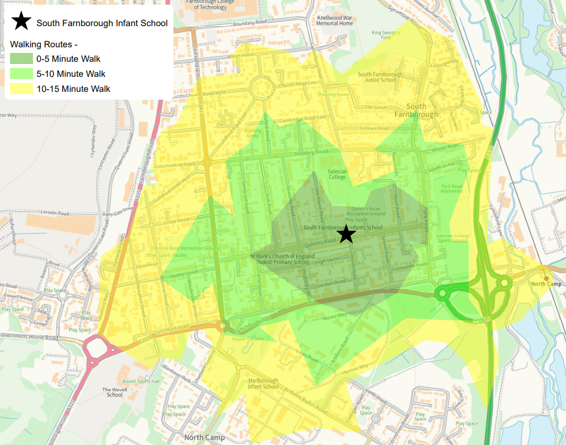


Getting to South Farnborough Infant School
If you live within the green or yellow 10 to 15-minute walking zones, you may find it quicker to walk to school than to drive and have to find a parking space
If you live beyond walking distance and must drive, please park and stride at either Peabody or Queen’s Road car parks and help make it safer around the school gates so more families can walk, cycle or scoot to school.
When parking on the street, always get your children out of the car on the pavement side.
Walk from a friend’s house: Know friends who live locally? Why not ask to park at their house and walk together for a sociable school journey
Lift share: Going the same way as a neighbour? Why not lift share and then park and stride, saving fuel and the environment.

