Slide 1
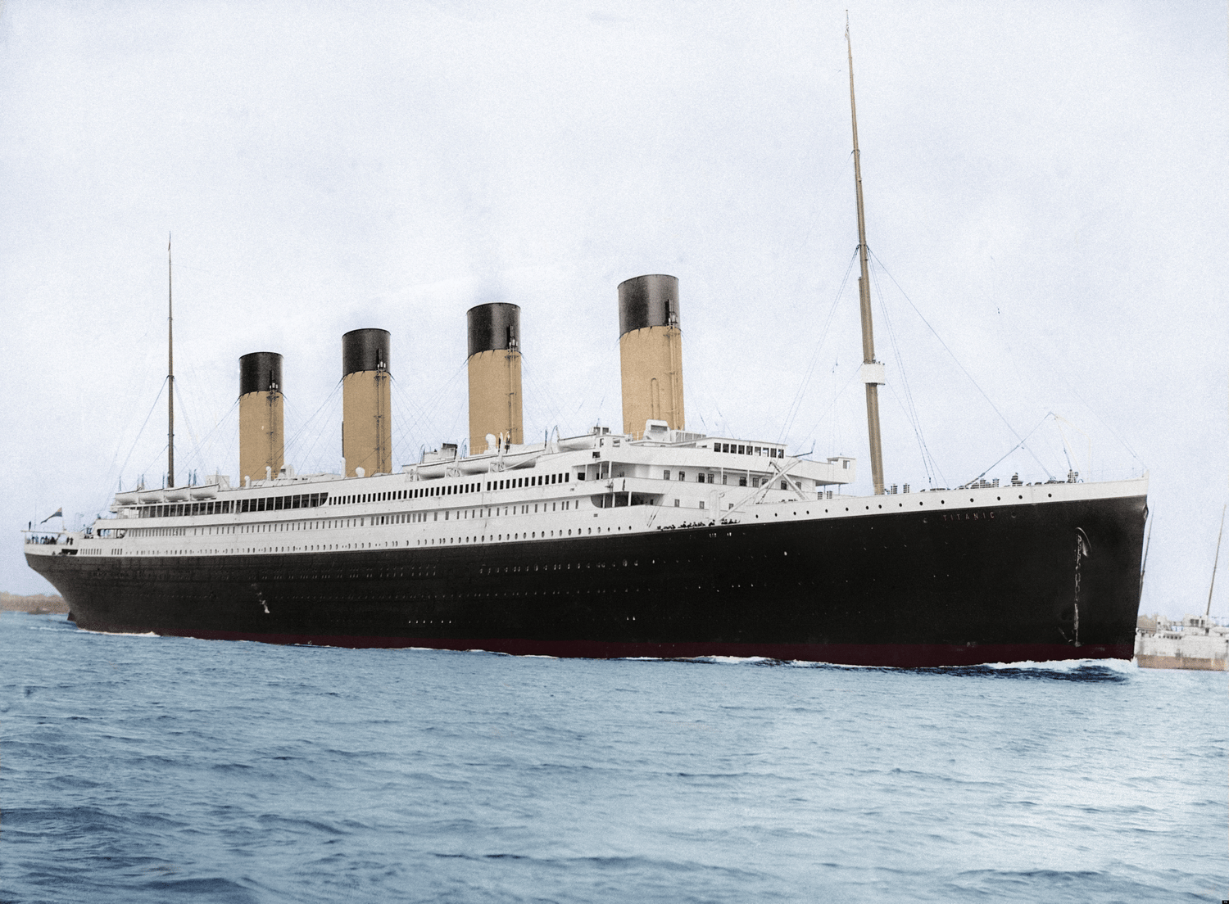
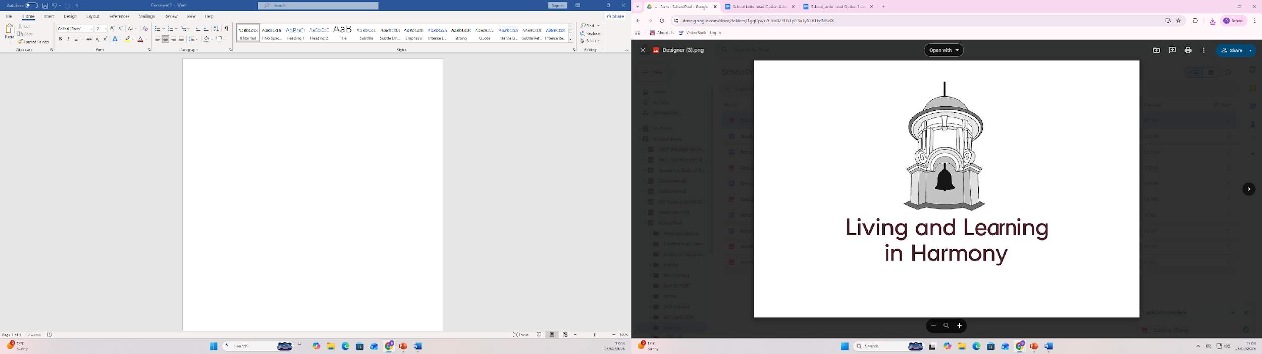
Titanic
Titanic - Tragedy or triumph
In this topic, children will: develop their understanding of history beyond living memory by exploring the Titanic as a significant event from 1912, learning to place it within a chronological framework and compare life in the early 20th century with their own time. They will investigate what the Titanic was, why it was considered unsinkable and special (including differences in passenger classes and onboard life), the sequence of events leading to its sinking, and the causes and consequences of the disaster. Through historical enquiry, children will use a range of sources such as artefacts, photographs, passenger stories, and timelines to ask and answer questions, make deductions, and recognise changes over time, including how the tragedy influenced safety improvements in shipping. They will also evaluate ways the disaster could have been prevented and reflect on its lasting historical importance. The key assessment strands in this unit are:
*I can explain what happened to the Titanic in 1912 and why it is remembered as an important event in the past.
* I can use historical sources to compare life on the Titanic with today and explain how the disaster made ships safer.
Our big topic questions will be - What are the best ways of stopping disasters such as the sinking of the Titanic ever happening again? Was it a triumph or a tragedy?
If you have any resources that would be useful to our learning , please contact your class teacher.
Dear Parents, ​
We have made it through to the last half
term of the academic year. We have
achieved so much and still our learning
keeps coming. Thank you for supporting
sports day and all other events that we
have had.
Please support your child at home by reading every day. This could be their reading book, school library book or a book from home. The more exposure to different texts, the better!
Thank you for your ongoing support
The Year 2 team.

Slide 2
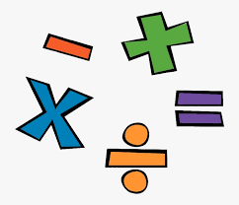
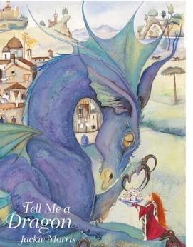
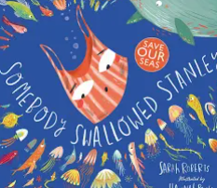

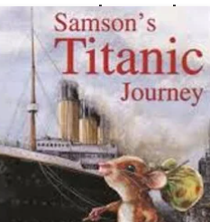

English
We will be focusing on the texts Traction Man, Somebody Swallowed Stanley and the book Samson’s Titanic Journey. Children will be continuing to gather new vocabulary, work on grammar and use these skills to enhance their own writing.
Maths
Our topics this term are
Telling the time
Problem solving
Position and direction
Data handling
Spellings
These words are quite tricky. Please practice them at home .
people
could
really
Said
History vocabulary
Titanic : a ship that was built which sunk on its first ever trip
Iceberg :- a massive chunk of freshwater ice that has broken off a glacier or ice shelf and floats in the ocean.
Disaster ;- a sudden, really bad event that causes a lot of damage, harm, or sadness to a community
Website
Please check out our website and in particular the school news section. This showcases the learning we have been doing and links to activities for different subjects
https://www.southfarnborough-inf.hants.sch.uk/school-news

Slide 3
Optional Learning Beyond the Classroom
Maiden Voyage:
Disaster
Tragic:
Collision:
Hypothermia
Ship / Boat:
Ice
Cold
Sinking
Night
Support your child at home by learning the meaning to some or all of these words.
If you choose to do any of these activities we would love for you to bring in photos to share with your class.
Creative Activities | Create a model of the titanic with iceberg Make a boat out of tin foil and see how many pennies it will hold before sinking. Design a ticket for the first class travellers on the ship. Use your best handwriting .
Things to do | Visit the seacity museum in Southampton Look at what floats and sinks
Research | Investigate the Titanic further Watch this you tube video on a walkthrough of what it would look like on the Titanic https://www.youtube.com/watch?v=UOCSs8JYU5o&t=47s
Iceberg
Hull
Lifeboat
Subject Specific words
Describing Words
Key Words
Words to help with my learning

