Slide 1
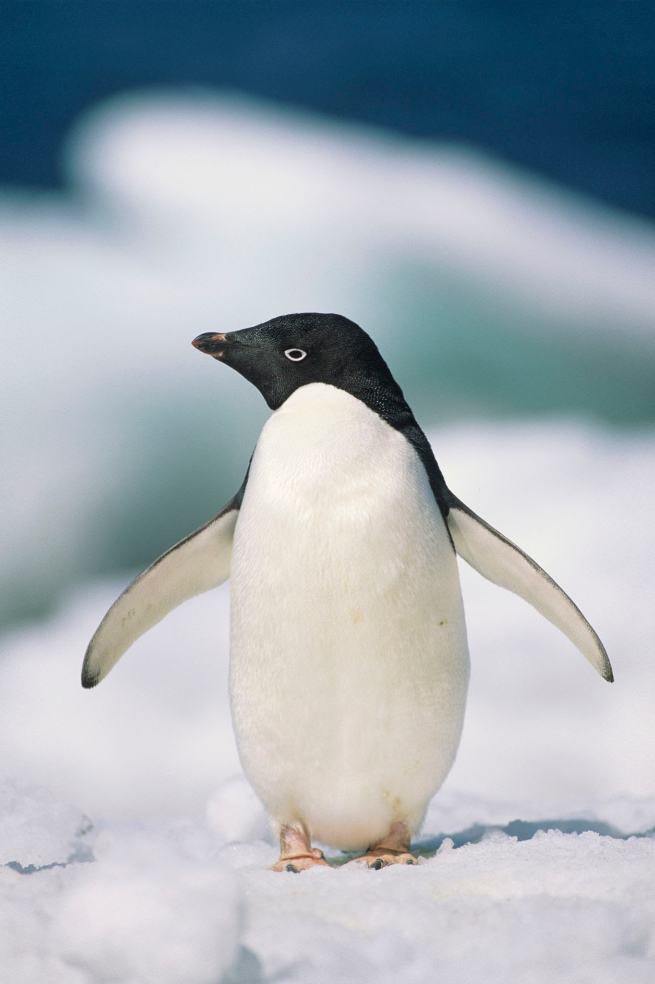
Reception Newsletter Summer 2
We have had a great half term learning about farm animals. Our trip to Wellington Country Park was a huge success and we were able to build on the children’s farm visit through craft activities and lots of discussions about animals. We have been using a variety of texts to find out information about animals too.
What are we learning?
Through our topic of Eddie the Penguin children will be finding out about Penguins and their habitat, exploring the changing state of ice to water and back again as it melts and refreezes. The children will also explore how human activity has an impact on the natural world and look at simple ways we can reduce this for example through recycling or reusing things we throw away and walking instead of using the car plus lots of other ways. They will share the things they find with you in our end of year celebration assembly.
To support your child in phonics this half term please continue to practice the reading book that comes home each Friday. It would also help your child to practice all the tricky words we have covered this year. Your child should be able to read them onsight both as a flash card and as they come up in their reading books. You can find all the tricky words at the end of the newsletter.
This is also a really special time of year for the children as they reflect on the their time in Reception and begin to look forward to Year One. Children will take part in a range of activities to help with their transition to Year One.
In Maths this half term we will be recapping concepts such as doubling, halving, sharing and number bonds to 10. We will also cover shape and measure looking particularly at capacity.

Slide 2
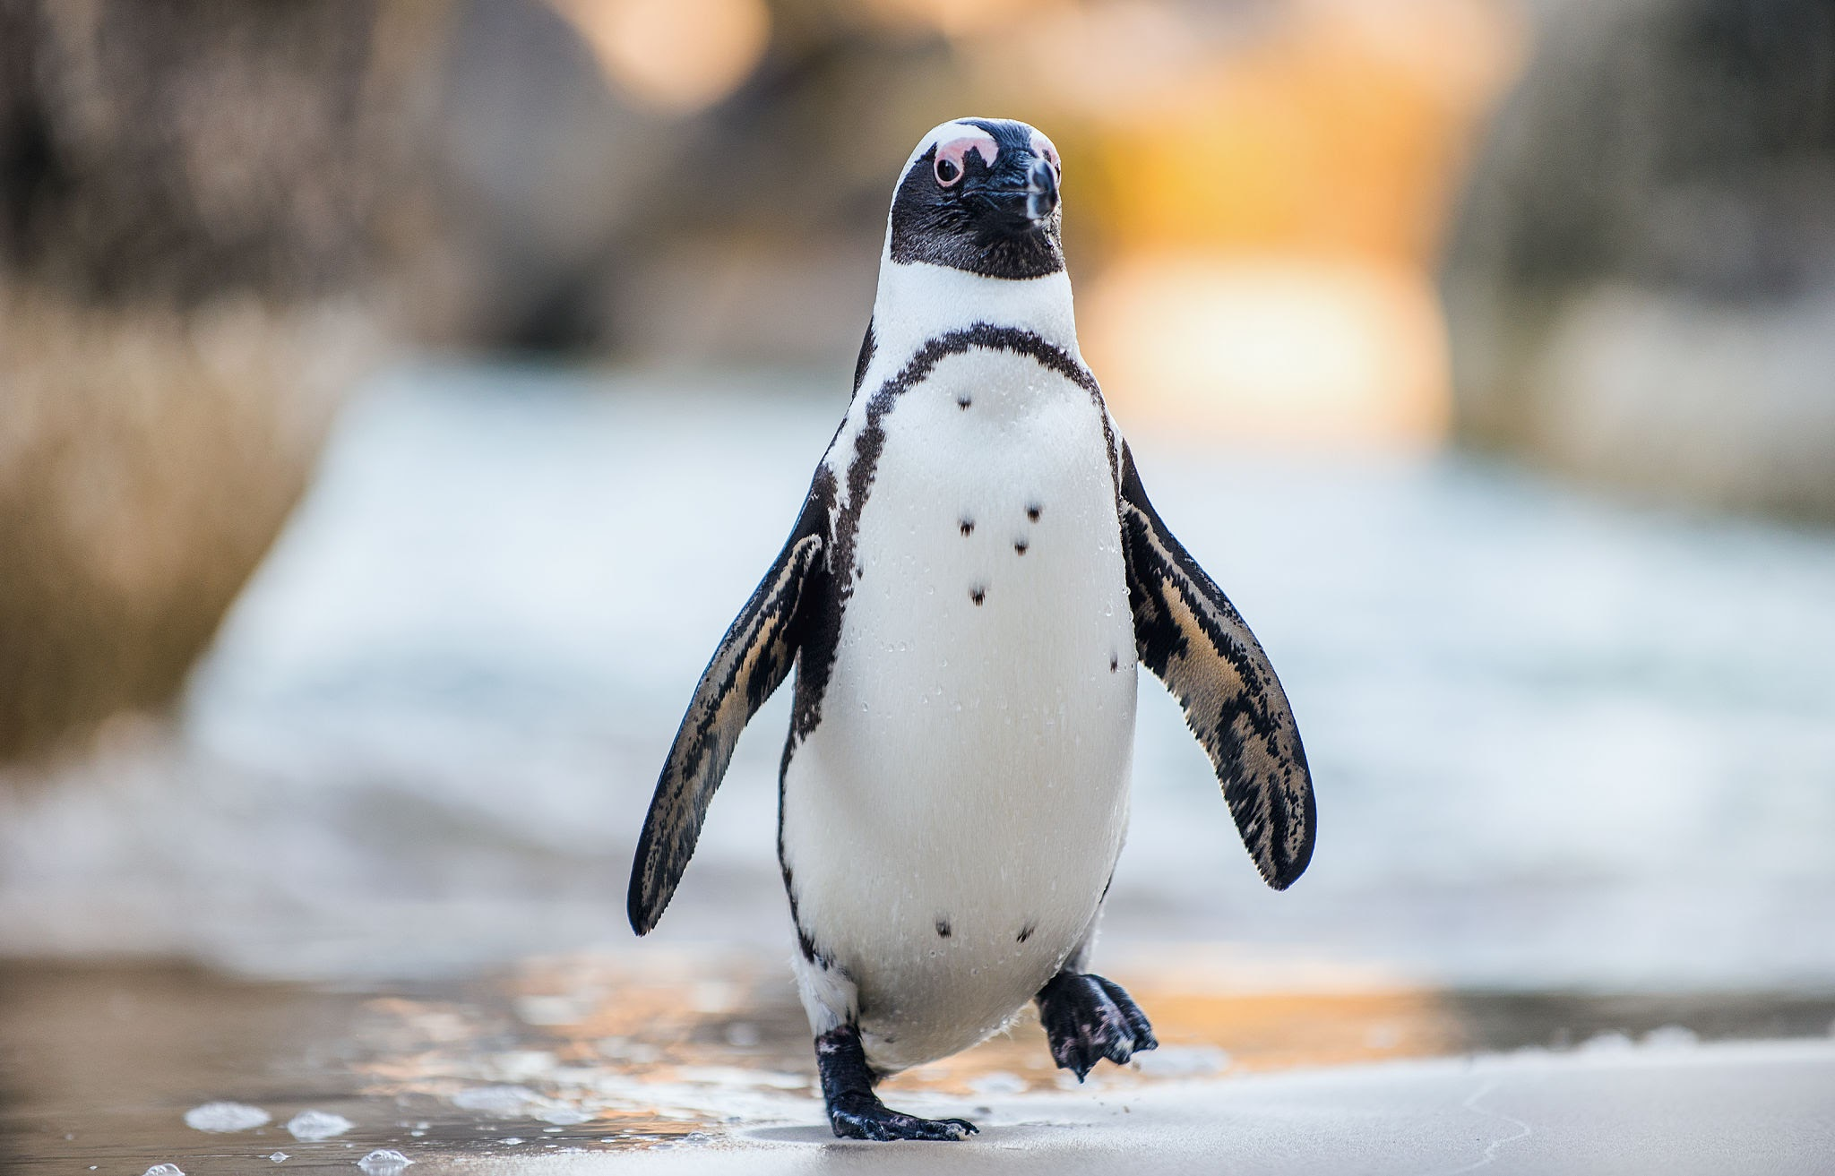
Optional Learning Beyond the Classroom
Support your child at home by learning the meaning to some or all of these words.
Creative Activities | Look at pictures of penguins and polar bears and use these to support your child in making their own representation. They could use drawing, painting or make a junk model
Things to do | Using uitable nature programs or books find out with your child how penguins move on land and in water, find out about their food, where they live etc. Help your child to freeze water in ice cube trays then let it melt encourage them to explore how it feels as water then as ice and to talk about what is happening and why.
Role Play | Find out how penguins and polar bears move and encourage your child to move in a similar way.
Eddie the Penguin - Key vocabulary
penguin, ice, iceberg, cold, Antarctica, water, sea, freeze, melt, recycle, reuse, reduce, polar bear,
Extension of vocabulary - there are lots of different species of penguins can you find the names of some of them for example Emperor Penguin, Rockhopper penguin
Words to help with my learning

Slide 3
Reception tricky words
Phase 2
and as be full go has he her his
I into is me no of pull push put
she the to we
Phase 3
all are by my pure sure they was you
Phase 4
come do have here like little love one out
said says so some there today were what when

