Slide 1
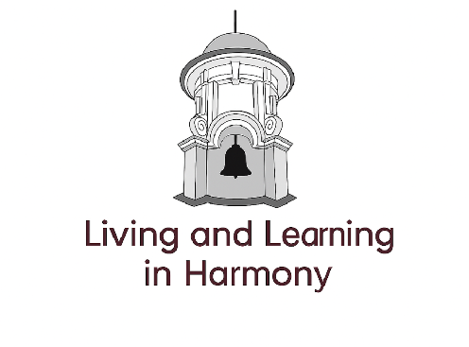
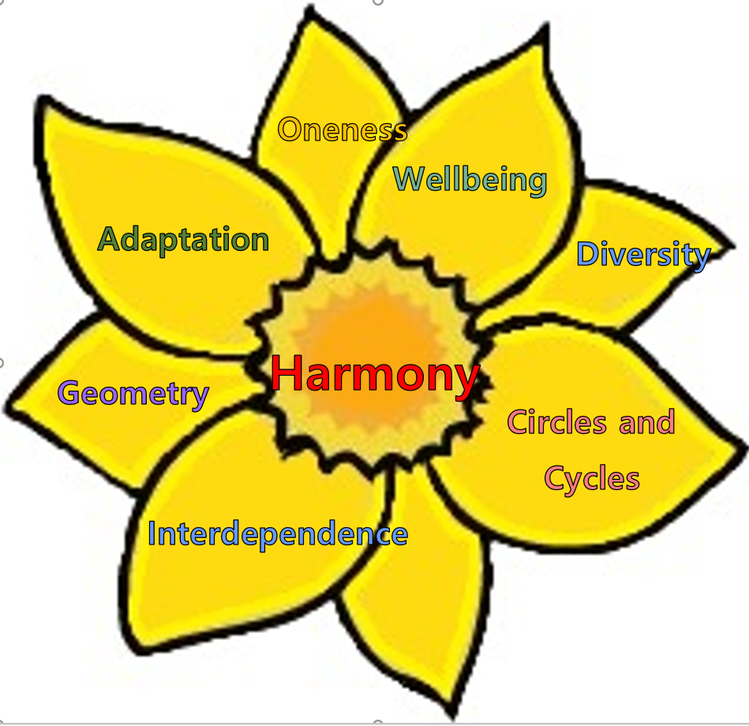
Welcome to South
Farnborough Infants School

Slide 2



School Visits

Slide 3

Information on:
Arriving/leaving school including timings, where to take or collect your child and late arrivals.
Parking around school.
Safeguarding
Absences
Medicine
Illness or accidents
Sun protection
Jewellery
Communication between home and school
News and information
Complaints
General data protection regulation
Policies
Food and drink including school dinners and packed lunches
School uniform
School Governors
Friends of SFIS
Parents in school
Website information

Slide 4
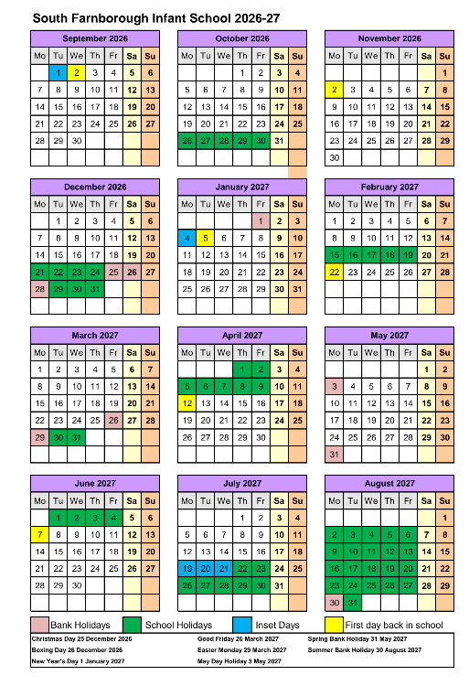
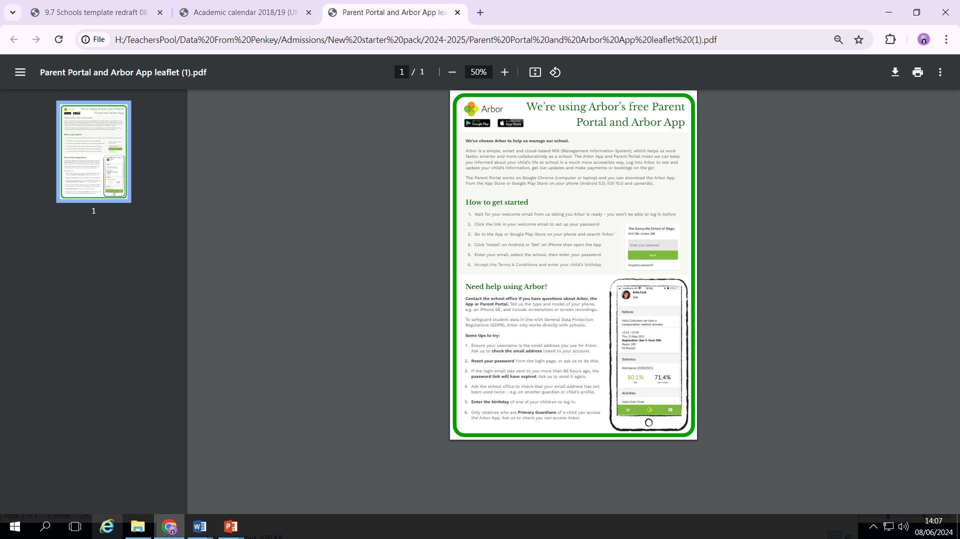
School Calendar
Arbor – parent portal

Slide 5
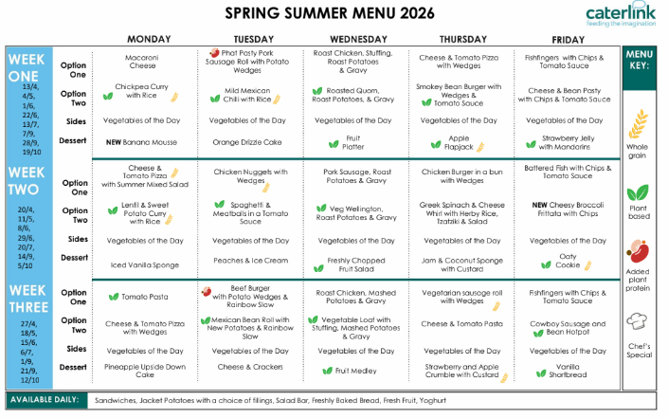
School Lunch Menu Example

Slide 6
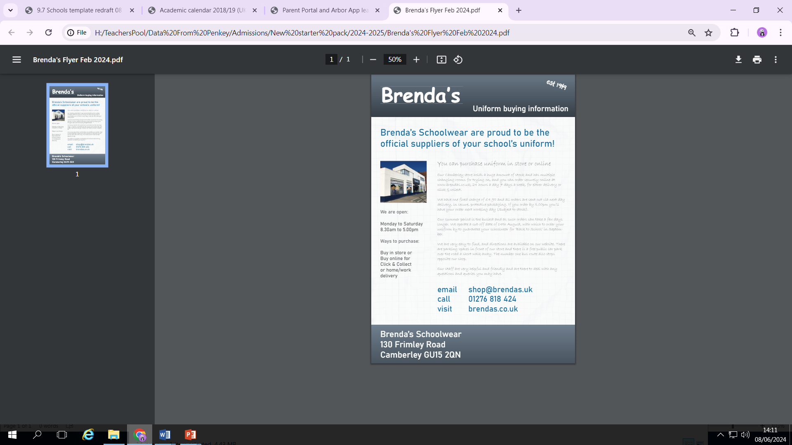
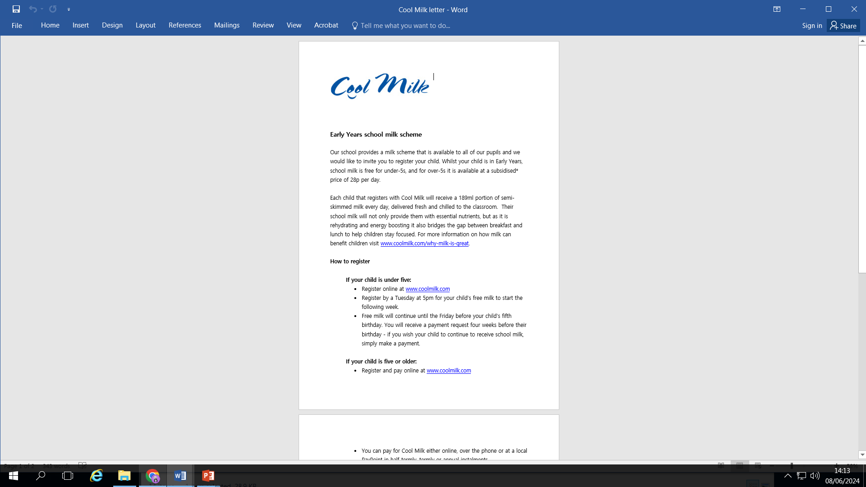


Slide 7
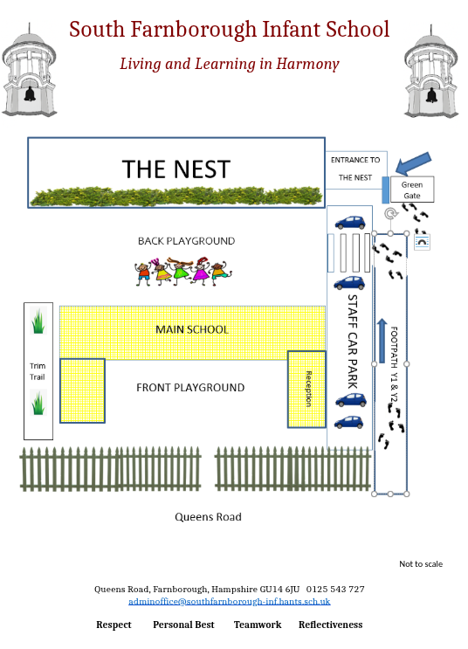
On each stay and play session/visit and when your child starts school, you will come through the park and in through the green Year R gate.
You will then walk up the car park and in through the black playground gates into the Year R outside area.
Then please make your way to the coloured bumpers (red, green or blue) for the visits and for the start of school.
Please collect your child from the same place each day.

Slide 8

Our Unique Harmony Curriculum

Slide 9
ACE– Before and after school Club
Notes:
Information about the before and after school club run by SCL

Slide 10
School Visits

Slide 11
Home Visits
What's the point of teacher home visits?
The home visit is really all about getting to know your child a little, telling you a bit more about the school set-up – and giving you an opportunity to speak confidentially about your child’s needs and development.
What can I expect at a teacher home visit?
A teacher and learning support assistant will come along. Don't worry: it's very informal.
We will introduce ourselves to the child, have a friendly chat and have a little play.
Children are often keen to show us their toys and this can then be a great talking point for us when your child starts school. We can also use this to help to distract them a little if they ever become upset.
We will fill out a form with basic information about your child, such as the language they speak at home, their eating habits, if they have any allergies or medical conditions or anything else we need to be aware of. Also we will ask which toys and books they like.

Slide 12
Do you need to prepare for the teacher home visit?
Dates and times are detailed in your pack, we do our best to stick to times but please bear with us if we are running late.
The only preparation that we recommend is making sure your child knows what's going to be happening. Talk in a positive way to your child about a teacher from their school coming and maybe get them to choose a favourite toy to show, just so they have something to share.
One thing you don't need to do is make sure the house is neat and tidy!
We honestly aren’t there to look at how tidy your house is! We are happy to see played-with toys and we really don’t care if you have piles of ironing!
“We're just there to meet you and your child."

Slide 13
The First Weeks of School
Activities around the classroom, hub and outdoor areas
Time to play with the other children and to make new friends
A Circle time when we get together to chat and find out about each other
A snack time
A play time out in the Year R play area
Lunchtime in our main school hall
A story time or a Year R assembly

Slide 14
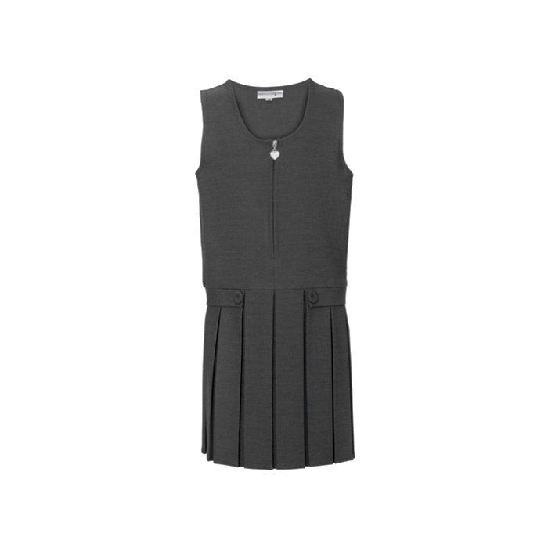
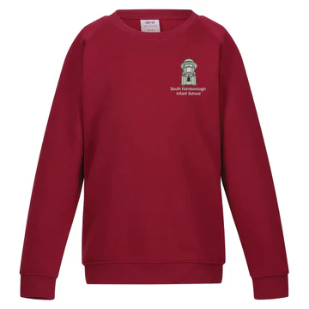
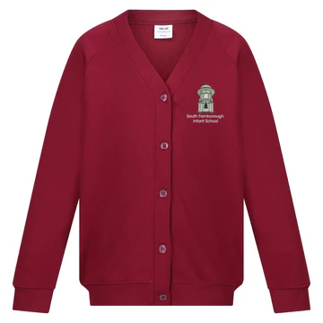
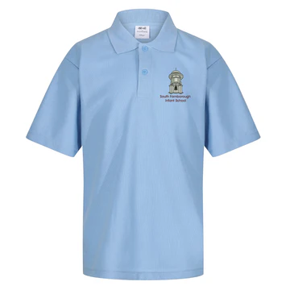
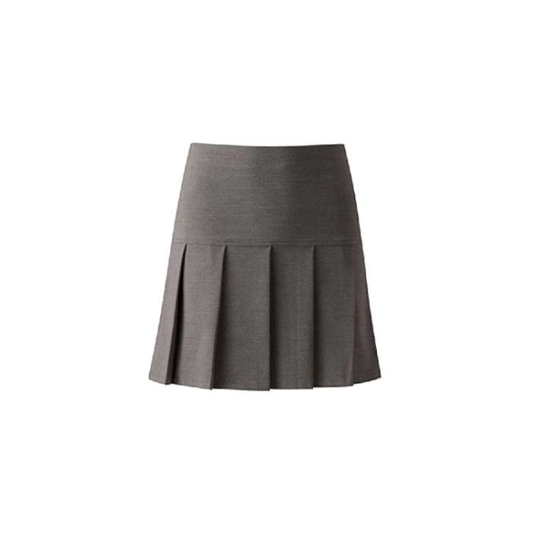
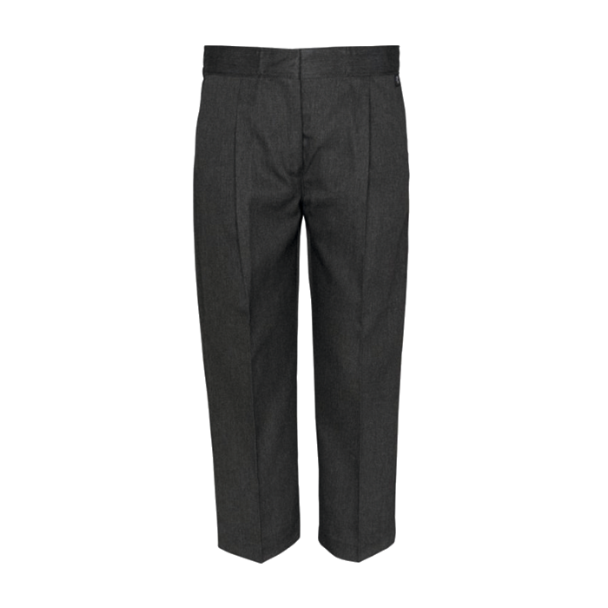
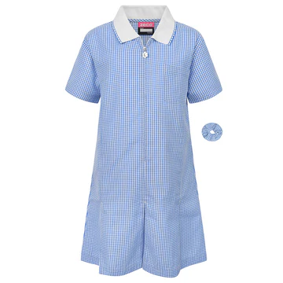
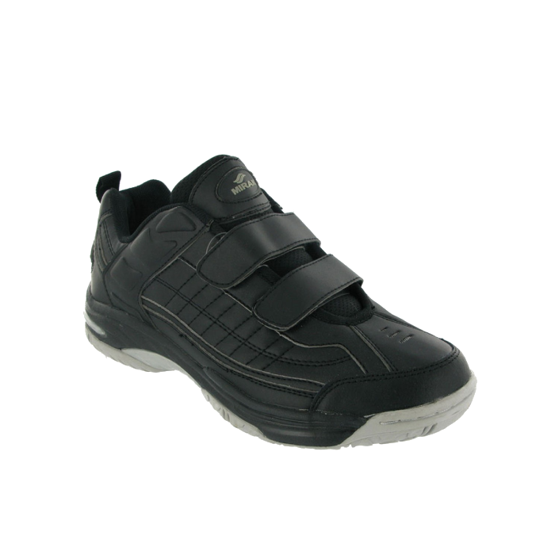
School Uniform

Slide 15
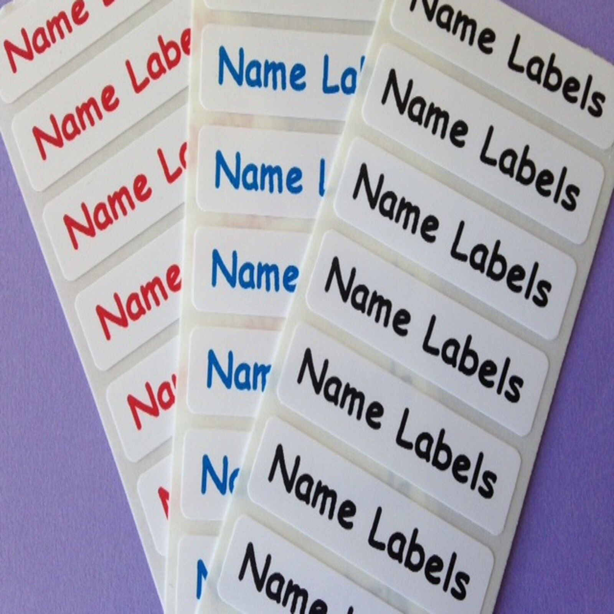
Please name everything!

Slide 16

Tapestry is award-winning software with tools to help educators work in partnership with families, document children's learning and development, and develop a child-centred approach to planning and assessment.
Each child will have their own online learning journal on Tapestry. This journal will enable us to follow your child's learning and development, and to plan experiences to help them to make progress. Through the journal we will share weekly 'observations' with you, which can be words, pictures and videos about your child's time here. You will also be able to use Tapestry to add pictures and videos of learning and experiences that happen at home. These will help us to get to know your child better - getting to know each child is at the heart of our good practice.
Please note that whilst home and school will be able to comment on observations, Tapestry is not a direct messaging service to staff, so please do continue to liaise with teachers in person or via the school office.
At the end of Reception, you’ll be able to download all of the photos and observations that have been uploaded over the year.

Slide 17

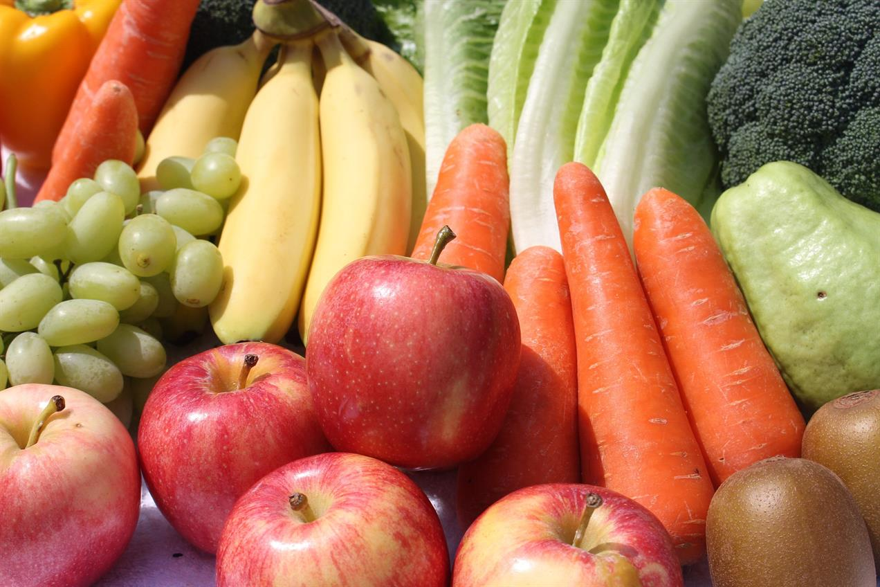

Slide 18
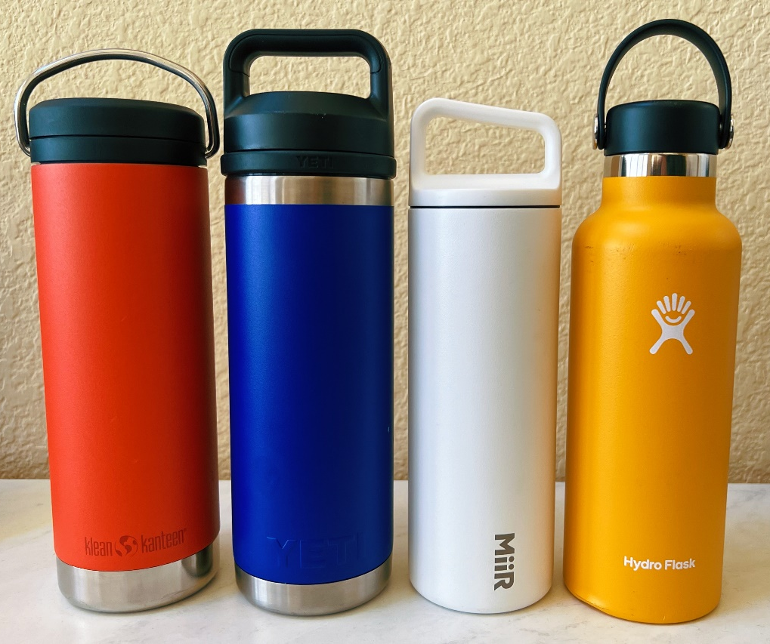
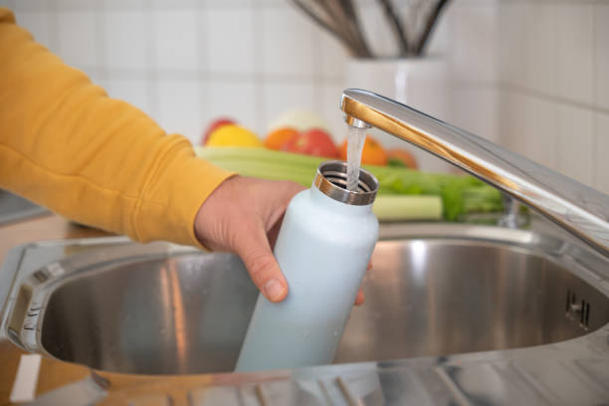
Water only please!

Slide 19

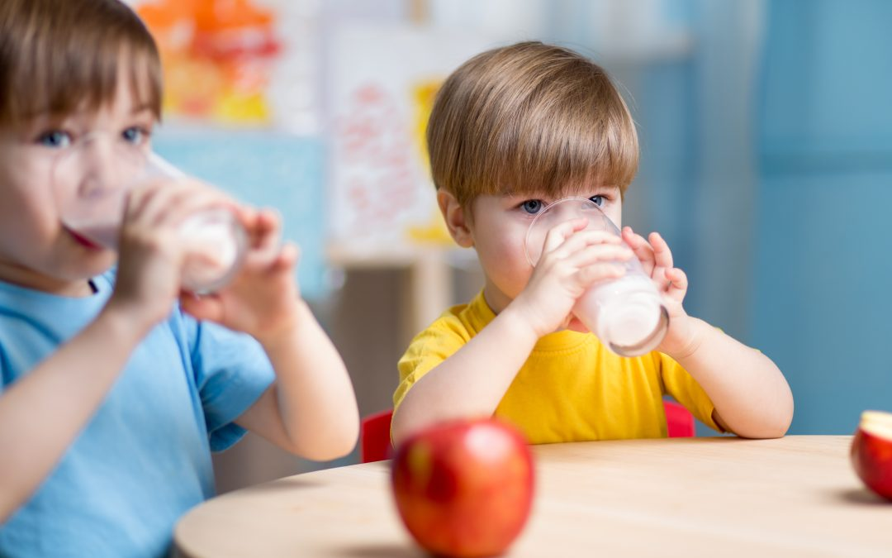

Slide 20
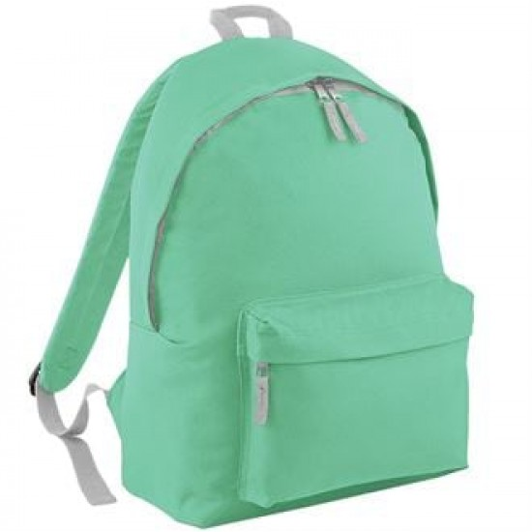
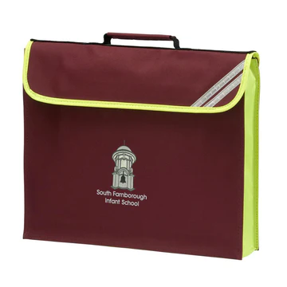
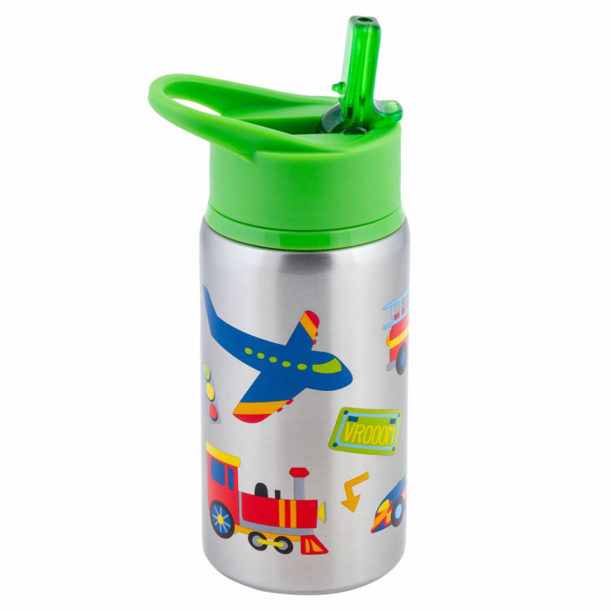



Slide 21




PE Kit

Slide 22
How to help your child prepare for school?
Self help skills:
Going to the toilet independently, wiping bottoms and washing hands
Putting a jumper on and taking it off
Doing up and undoing buttons
Putting on their coat and zipping it up
Putting on a pair of gloves
Using a knife and fork
Wiping their nose
Recognising their own name written down
These skills will help them to settle quickly into school life. We won’t let them flounder if they can’t do these things but the sooner they can do these things, the quicker they can start on learning all sorts of other things!

Slide 23
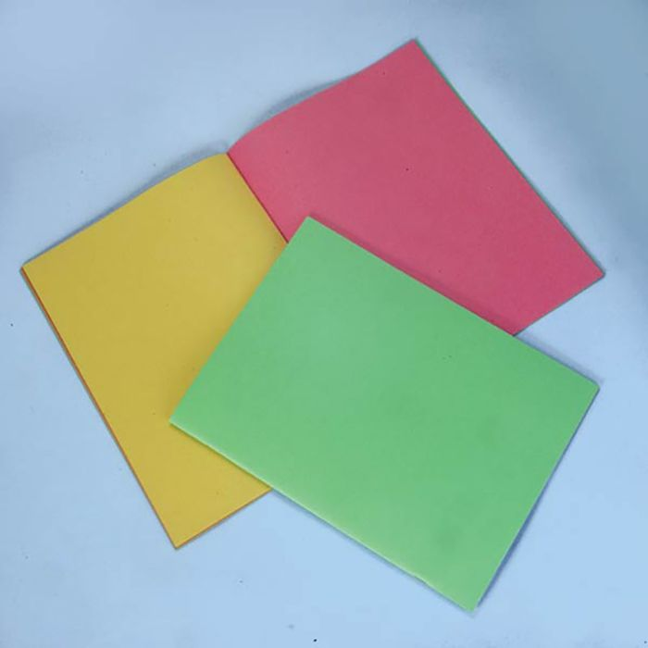
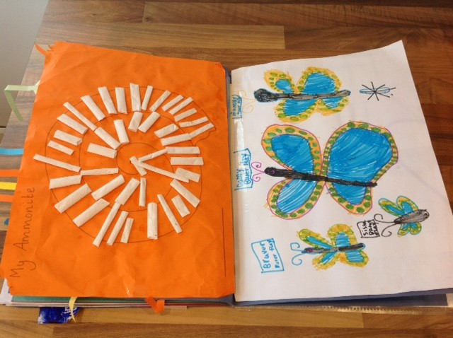
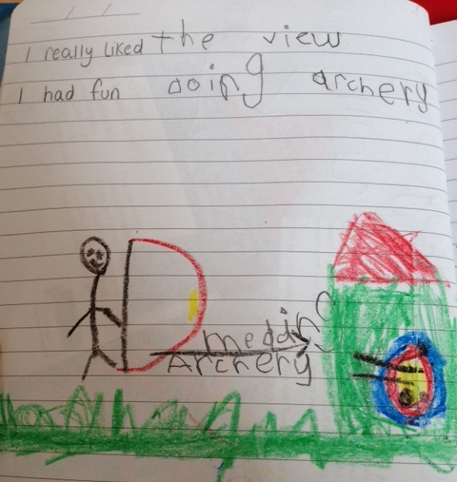
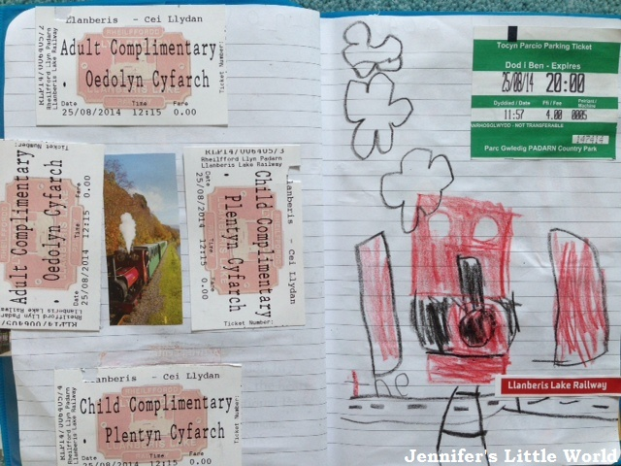
Year R scrap books
These are for your child to record anything they do each school holiday. The first page is for the children to give information about themselves and their family e.g brothers, sisters, pets, favourite colour, and anything else they would like to tell us about. In the rest of the book, they can stick things from their holidays starting with this summer before they start school. They can include tickets, photos, leaflets of places visited, drawings etc. Each school holiday they will bring their scrap book home so they can add to it.

Slide 24
School Website
Please visit our school website and subscribe to the school calendar, this will keep you up to date with all of the key things happening at school.
The website also has information on:
Our Harmony Curriculum
Our current staff members
Governors
Policies
Safeguarding
Online safety
Special Educational needs
Performance data
Wraparound care
Phonics
Attendance
Newsletters
Term dates
Parent support advisor information
Year Group information
Fundraising
Friends of SFIS

Slide 25

Birthdays!
We always celebrate the children’s birthdays in school. The class will sing to your child on their special day and we will ask them about their celebrations. Children can also celebrate by wearing their own clothes on their birthday or the nearest school day to it. As we are a healthy school, please do not bring in any sweets or cakes to give out on your child’s birthday, you can do any celebrations with their friends outside of school.

Slide 26
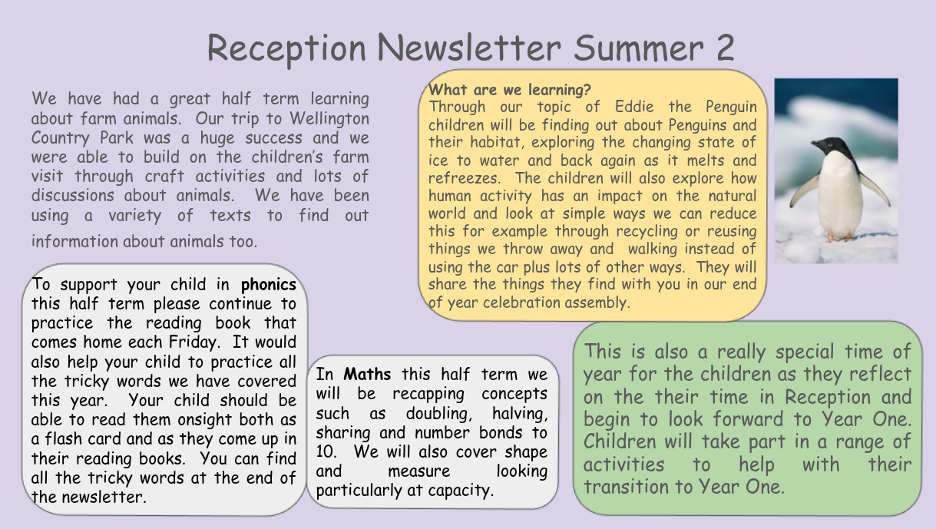
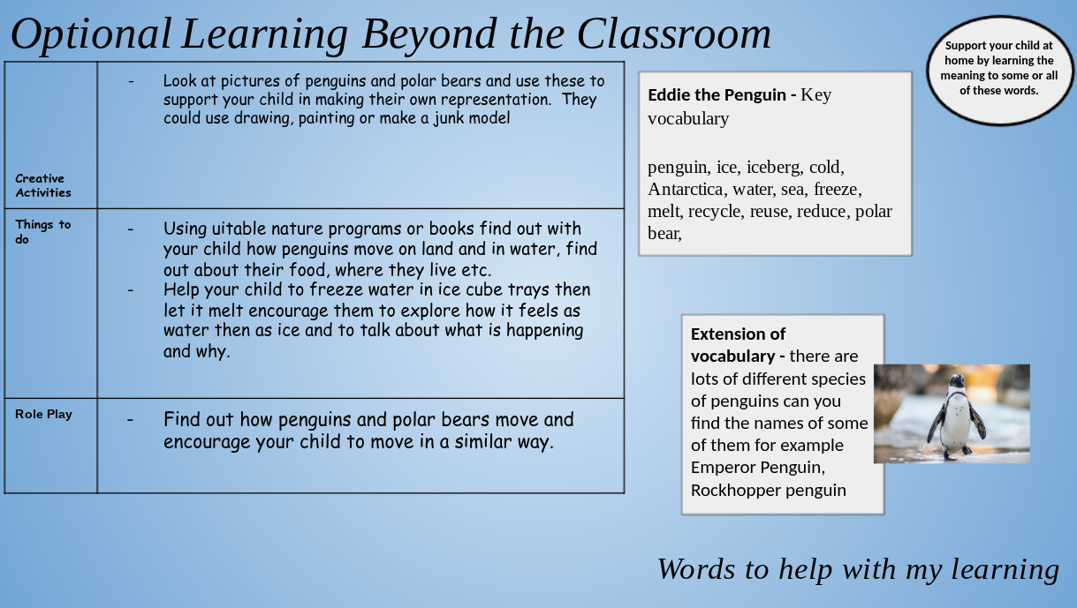
Newsletters
Lastly I need to tell you about our Early Years Newsletter which will be emailed to you half termly and is also available on the website. This will give you information about what the children will be learning in school for that half term. The second page gives you key vocabulary that we will be using in our topics and suggest some ideas for you to support your child at home.

Slide 27
Farnborough Library
Starting School Meet and Connect
July 8th 1.30-2.30

Slide 28


Thank you for coming tonight.
We hope you are now armed with all the information you need about your child starting school at South Farnborough Infant School.
Any questions?

