Slide 1
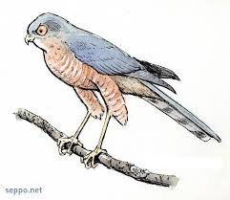

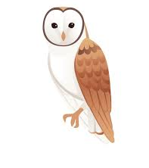
Welcome to Year 2
Sparrohawks
Mrs Morris Mrs Thomson
Mrs Baker
Mrs Maynard
Ms Willis
Barn Owls
Mrs Carter
Mrs Maynard
Mrs Harley
Kestrels
Miss Powell
Mrs Kerner

Slide 2
Housekeeping
Uniform
All children should come to school wearing labelled uniform. Year 2 children are expected to collect their own belongings at the end of the day (with guidance where needed). Therefore, clearly labelled items are essential. All lost property will be gathered at the school office and the end of each week.
Newsletters/ Questions
You will receive a half-termly newsletter from the Year Two team, to share learning and events that have taken place in school. This will be sent to the email address you provided.
Please contact the office or member of teaching staff at the door (during morning drop off) if you have any concerns or questions.
End of Day Collection
When collecting children from their class shapes, please wait for the teacher to dismiss your child before taking them. This is part of our safeguarding procedures.

Slide 3

Reading and Phonics
Daily Phonics
Phase 2
Phase 3
Phase 4
Phase 5
Spelling
Reading 3 times a week
Books home on a Friday
Collected back in on a Monday
Books will be signed in and out by teachers and MUST be returned on a Monday.
Charges will be issued for lost or damaged books.
Library
Children will visit the library every week. Sparrowhawks will visit on Thursdays
Please have these in bags each week so they can be changed.

Slide 4

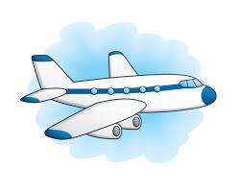
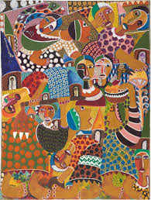
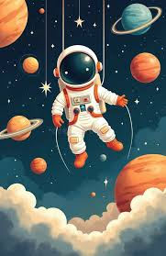
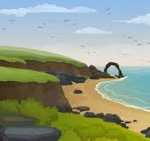

Yearly Overview
Autumn 1
Space
How did Neil Armstrong and Mae Jemison help us learn more about space?
Autumn 2
Rainforests
Why does the world need rainforests?
Spring 1
African adventure
How is life in Africa different from life in England?
Spring 2
Flight
What did Samuel Cody teach us about flight?
Summer 1
Britain’s Coastline
What are Britain’s coastlines used for?
Summer 2
Oceans
Why are our oceans magnificent?

Slide 5
Things to remember
PE days
Sparrowhawks on Monday and Friday
Kestrels and Barn owls on Wednesday and Friday
Homework/spelling
Spelling – Children will take home weekly spellings. Please practice these at home with your child.

Slide 6
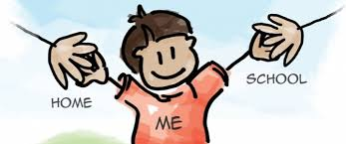

Questions
Open door policy – please always speak to one of the grown ups if you need anything.
We value the home-school partnership!

