Slide 1
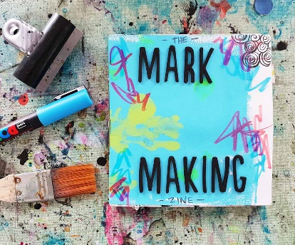

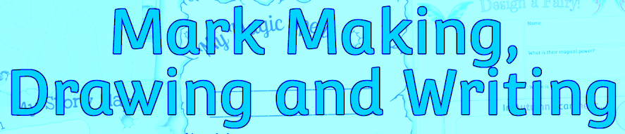
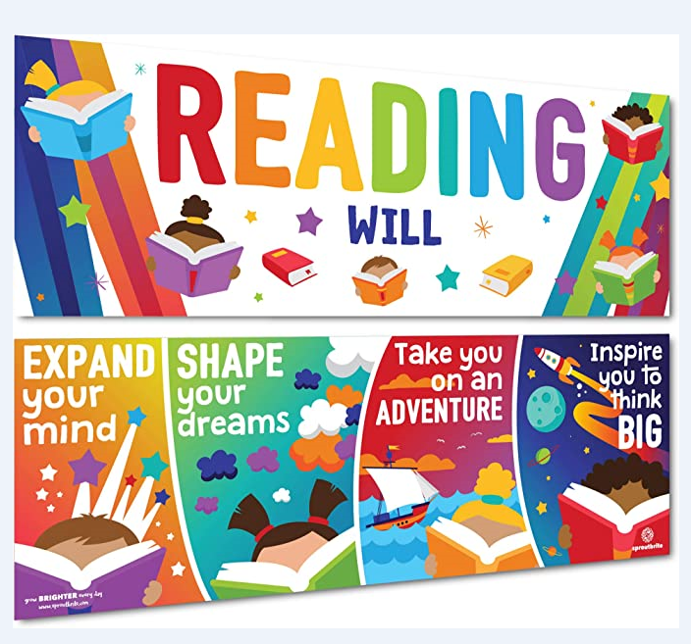


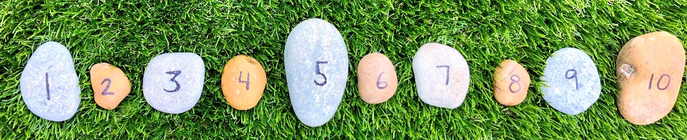
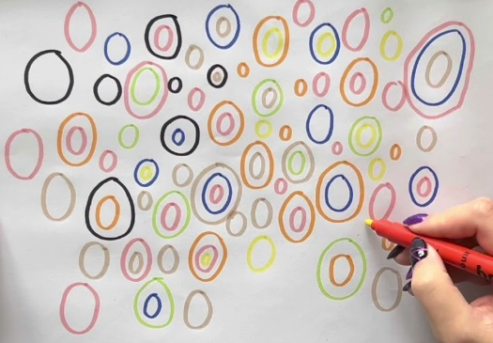
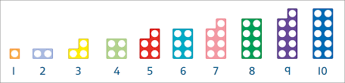
SFIS Reception Information Evening

Slide 2
Seven Areas of Learning: There are seven areas of learning and development. These are divided into three Prime areas and four Specific areas. All areas of learning and development are important and inter-connected. All of these areas are particularly crucial for igniting children’s curiosity and enthusiasm for learning, and for building their capacity to learn, form relationships and thrive.
Prime Areas of Learning: Prime Areas are fundamental; they work together and support development in all other areas.
Personal, Social and Emotional Development
Involves helping children to develop a positive sense of themselves, and others; to form positive relationships and develop respect for others; to develop social skills and learn how to manage their feelings; to understand appropriate behaviour in groups; and to have confidence in their own abilities.
Physical Development
Development involves providing opportunities for young children to be active and interactive; and to develop their co-ordination, control, and movement. Children must also be helped to understand the importance of physical activity, and to make healthy choices in relation to food.
Communication and Language Development
Development involves giving children opportunities to experience a rich language environment; to develop their confidence and skills in expressing themselves; and to speak and listen in a range of situations.

Slide 3
Specific Areas of Learning: Specific Areas include essential skills and knowledge for children to participate successfully in society.
Literacy
Involves encouraging children to link sounds and letters and to begin to read and write. Children must be given access to a wide range of reading materials (books, poems, and other written materials) to ignite their interest.
Mathematics
Involves providing children with opportunities to develop and improve their skills in counting, understanding and using numbers, calculating simple addition and subtraction problems; and to describe shapes, spaces, and measures.
Understanding The World
Involves guiding children to make sense of their physical world and their community through opportunities to explore, observe and find out about people, places, technology and the environment.
Expressive Arts and Design
Involves enabling children to explore and play with a wide range of media and materials, as well as providing opportunities and encouragement for sharing their thoughts, ideas and feelings through a variety of activities in art, music, movement, dance, role-play, and design and technology.

Slide 4
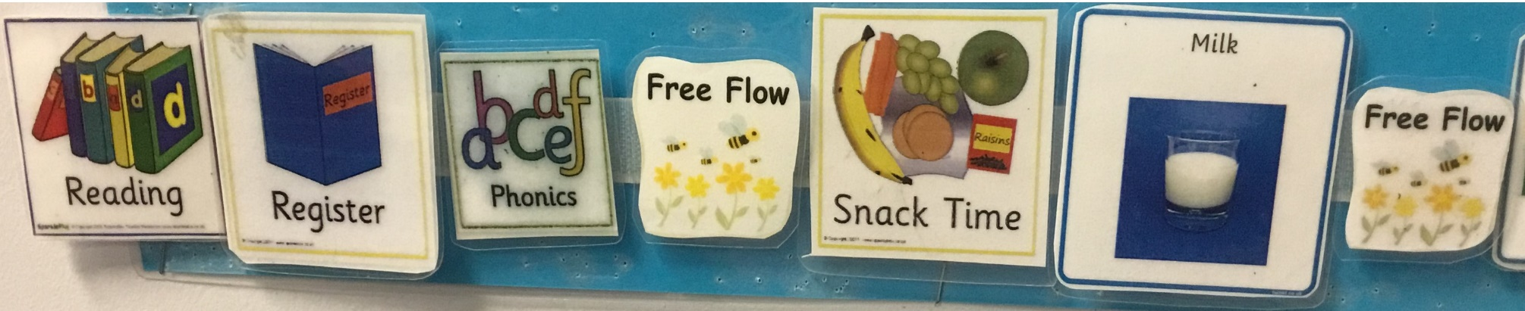
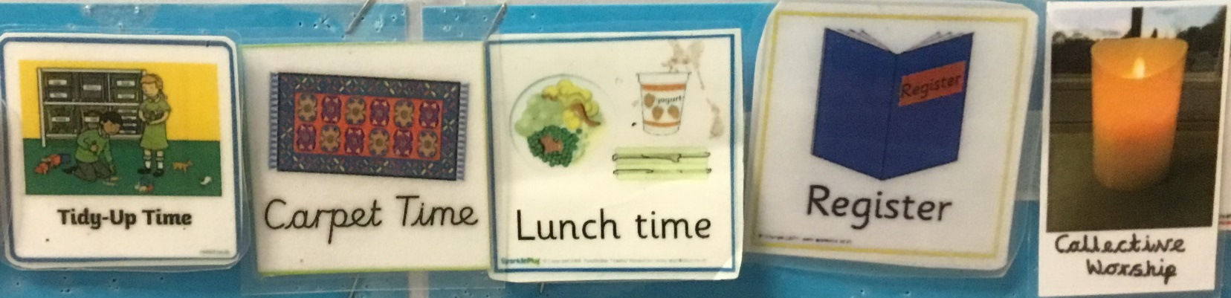
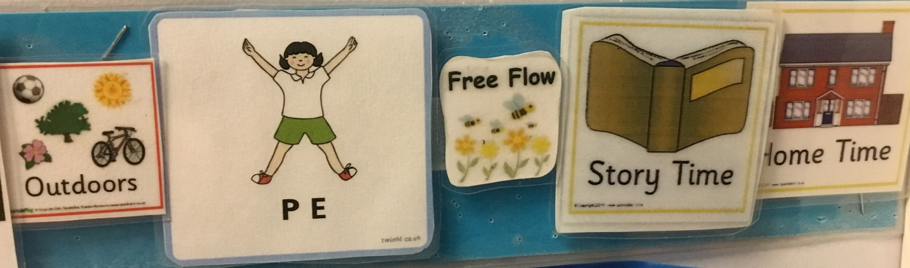
A Typical Day in Reception

Slide 5
Phonics is…
“making connections between the sounds of our spoken words and the letters that are used to write them down.”

Slide 6

By the end of Reception children are expected to:
• Say a sound for each letter in the alphabet and at least 10 digraphs.
• Read words consistent with their phonic knowledge by sound-blending.
• Read aloud simple sentences and books that are consistent with their phonic knowledge, including some common exception words.

Slide 7

Little Wandle Letters and Sounds Revised
Our school teaches Little Wandle Letters and Sounds Revised
This is a government recommended phonics programme, which aims to ensure all children can fluently decode and read texts using phonics by the end of Year 1.
It is a complete synthetic phonics programme with a consistent approach that uses daily phonics teaching sessions, group reads along with catch-up interventions and half-termly assessments.
It is vital that you as parents/carers understand and support the school through this process as you play such a significant role in helping your child learn to read and develop a love of reading.

Slide 8
A Typical Phonics Session
We start each phonics session with a recap of the sounds learnt so far.
Then we learn the new phoneme for the day and look at the grapheme and mnemonic
What’s in the box? We look at pictures beginning with the new sound.
Oral blending - children copy and say the word (my turn, your turn)
Teacher led blending
Tricky words
Writing the new grapheme on a whiteboard.
Oral blending game
This will change slightly over the year as the children become more familiar with the phonemes

Slide 9
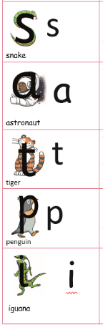
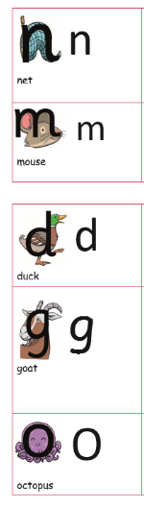
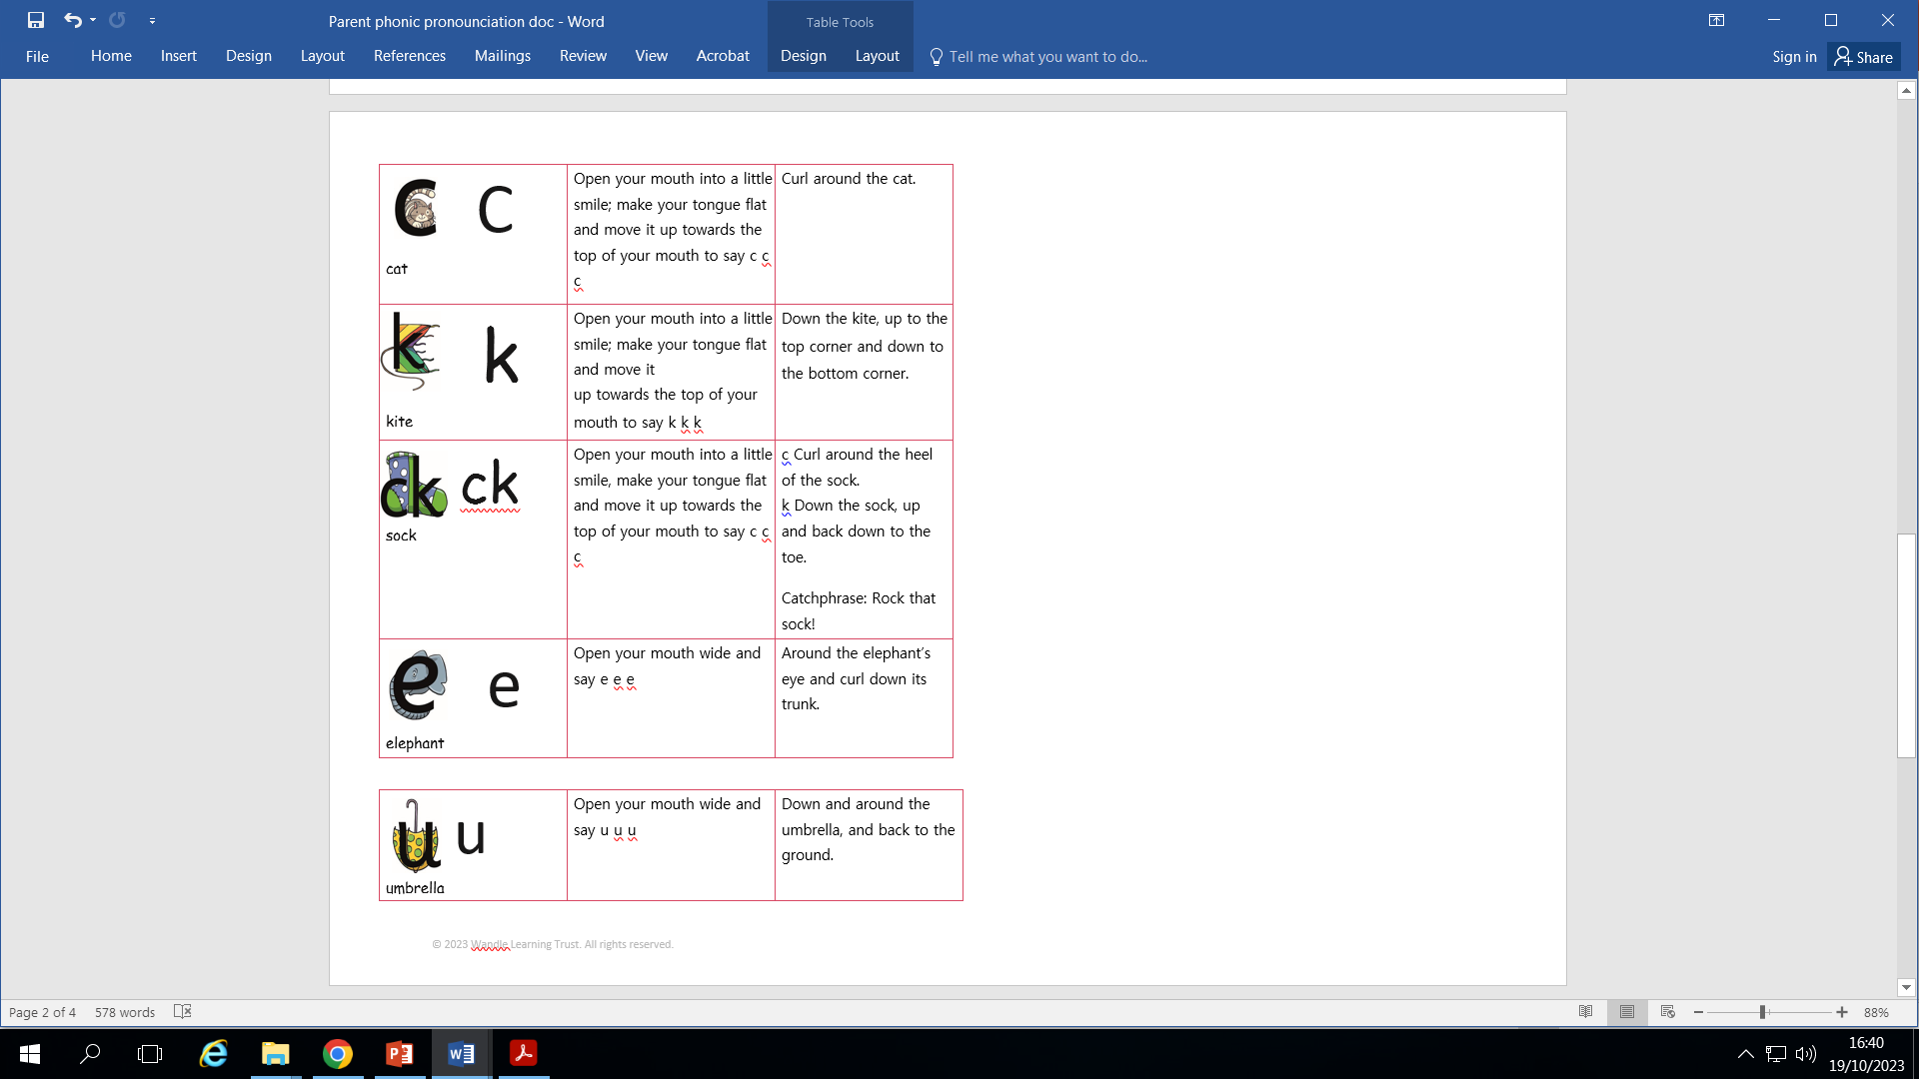
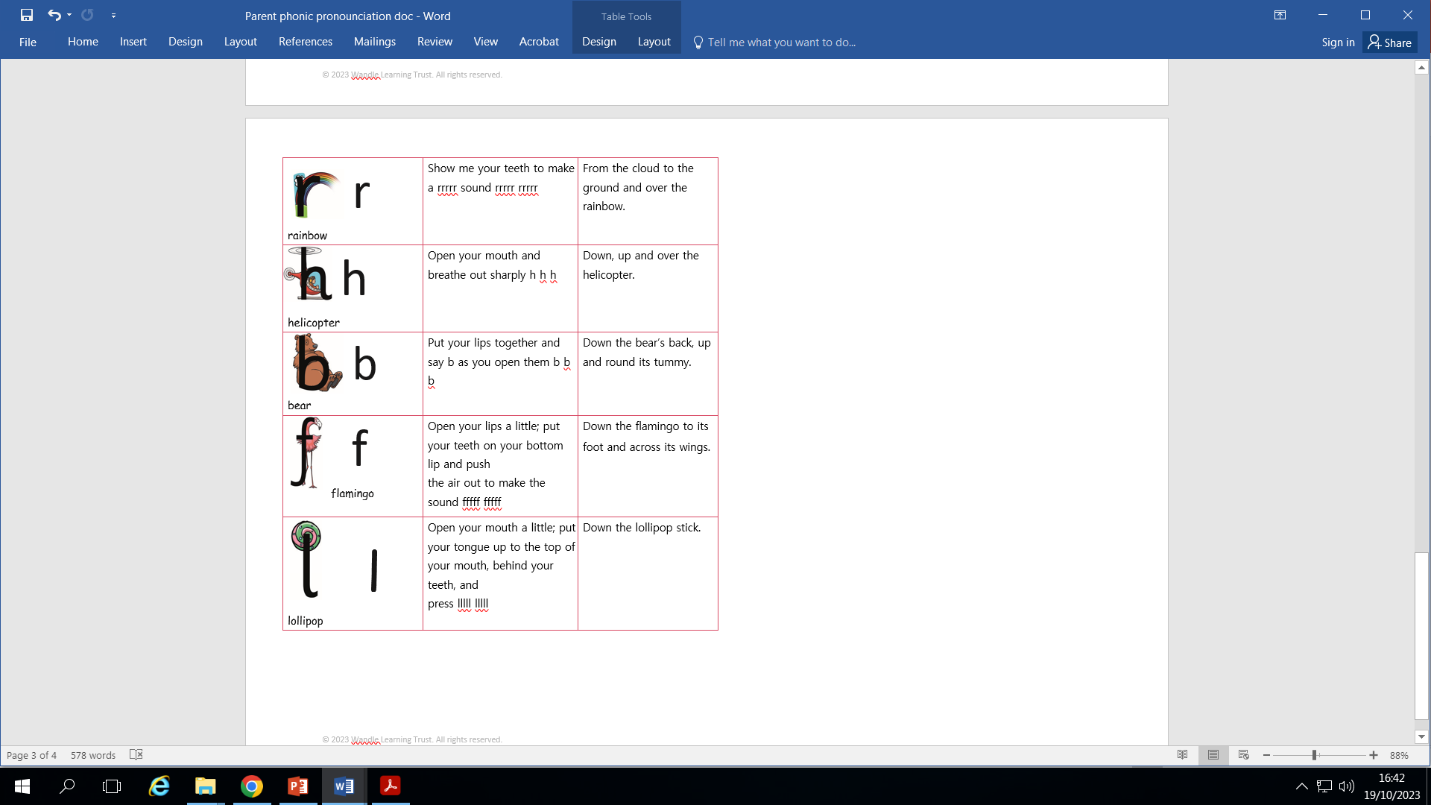
Teaching order
Notes:
We usually teach four new sounds a week and have a review lesson on a Friday. You will get a list of the sounds that we are learning to have at home. This will help you with formation and pronunciation.

Slide 10

Research has shown that being able to read fluently by the age of 6 has a strong correlation with future academic success.
If children can read fluently, they are better able to access all areas of the curriculum.
‘If we learn to read, we can read to learn.’
Decoding using phonics is the most reliable method to work out unknown words which is why automatic decoding is the ultimate aim of the programme.

Slide 11

Supporting your child with phonics
Notes:
It is really important that you pronounce the sounds correctly at home if you are supporting your child. These videos are on the website for you to refer to and if you are unsure, please ask your child’s teacher.
Show the parents where to access the videos on the website and play them!
https://www.littlewandlelettersandsounds.org.uk/resources/for-parents/

Slide 12
Terminology
Phoneme: The smallest unit of sound that can be identified in words. We also use the term ‘sound’ but your child may use the word ‘phoneme’. There are 44 phonemes or sounds in the English language.
Grapheme: A letter or group of letters used to represent a phoneme in writing.
Decode: To break down (‘sound out’) a written word into sounds then blend the sounds together to read the word.
Digraph: A grapheme made of two letters that represent one sound. An example is the ‘sh’ in ‘shop’.
Trigraph: A grapheme made of three letters that represent one sound. An example is the ‘igh’ in ‘night’.

Slide 13
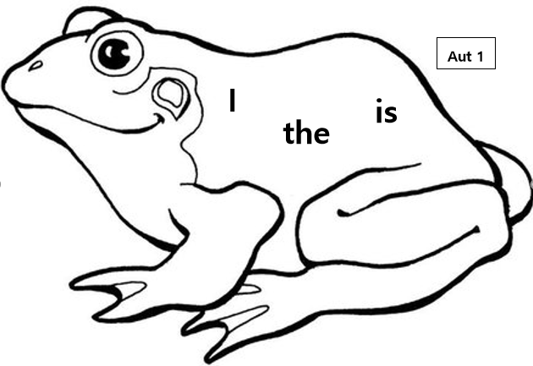
Tricky Word Animal Bookmarks
‘Tricky words’ are words that cannot easily be decoded (‘sounded out’ and read). This is because some of the sounds in the words are spelled in an unusual way. It is important for children to be able to read these words as they are among the most common words in English.
Children will practise the tricky words in school until they can read them automatically. They will also practise reading the tricky words in the decodable books that they bring home.
Your child will receive their first tricky word animal bookmark to bring home. Please encourage your child to practice these tricky words by sight. To support your child in learning these tricky words you could:
Write them a sticky notes or paper and put around the house.
Play snap with the words
Spot the words in other books, on the back of their cereal packet etc.

Slide 14
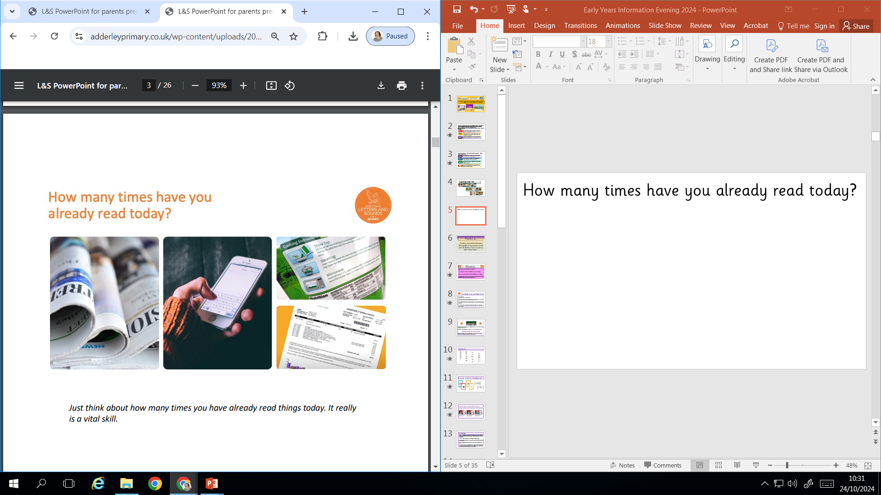
How many times have you already read today?
Just think about how many times you have read things today. It really is a vital skill.

Slide 15
Reading in Reception
By the end of Reception children are expected to:
Word Reading
Read words consistent with their phonic knowledge by sound-blending.
Read aloud simple sentences and books that are consistent with their phonic knowledge, including some common exception words.
Comprehension
Demonstrate understanding of what has been read to them by retelling stories and narratives using their own words and recently introduced vocabulary.
Anticipate key events in stories.
Use and understand recently introduced vocabulary during discussions about stories, non-fiction, rhymes and poems and during role play.

Slide 16

Blending to read words
Some children learn to blend really quickly, and others take a little longer. That’s fine. We have lots of opportunities to practice this skill at school.
You can watch the blending video by visiting the Little Wandle website at: https://www.littlewandlelettersandsounds.org.uk/resources/for-parents/
Notes:
Some children learn to blend really quickly, and others take a little longer. If your child is finding it difficult, ask your child’s teacher for ways to help at home – playing blending games at home is so helpful!
Show parents this video from the website: https://www.littlewandlelettersandsounds.org.uk/resources/for-parents/

Slide 17

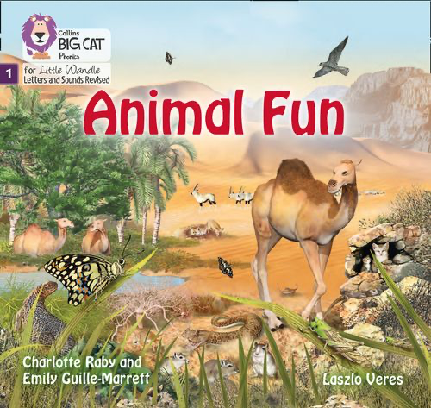


We use assessment to match your child the right level of book
Notes:
We assess your child every six weeks to check progress. Any child who needs extra support has daily keep-up sessions planned for them.

Slide 18

Reading a book at the right level
This means that your child should:
Know all the sounds and tricky words in their phonics book well.
Read many of the words by silent blending (in their head) – their reading will be automatic.
Only need to stop and sound out about 5% of the words by the time they bring the book home – but they should be able to do this on their own.

Slide 19
Wordless Books
If your child is not yet secure in their letter recognition then they will bring home a wordless book.
Before looking at the book please practise saying the sound that each of the graphemes makes.
Then look at the book together with your child, getting them to talk about the front cover first.
Ask questions like – what do you think the book is about?
Then look through the book together talking about the pictures and making up a story.
Choose a page in the book where there are lots of things and do an initial sound hunt.

Slide 20
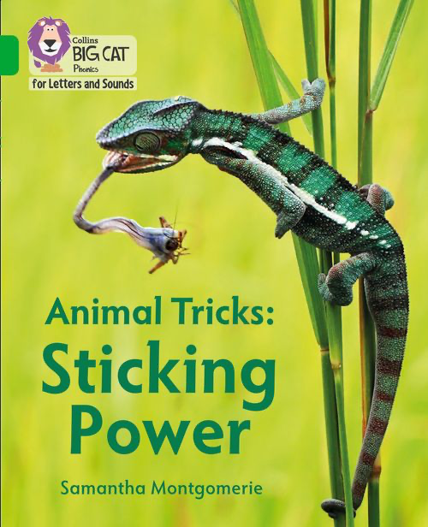
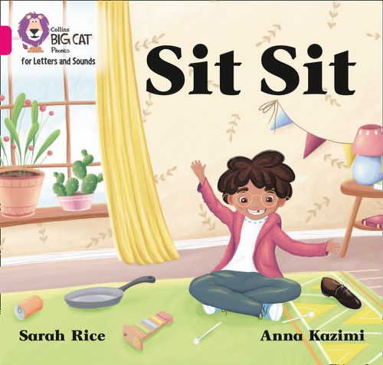
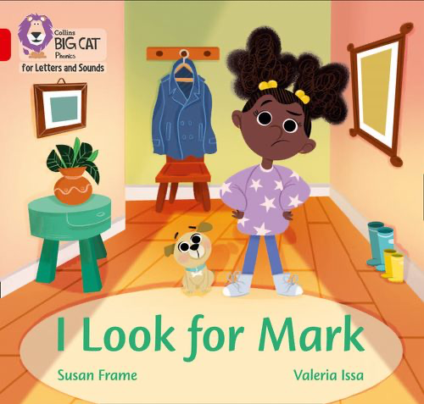
How do we teach reading in books?
Reading practice sessions are:
timetabled three times a week
taught by a trained teacher/teaching assistant
taught in small groups
The children read the same book three times in a week. The first time we work on decoding (sounding out) the words, the second time we work on prosody which helps them to read in an interesting way, with expression – using our story-teller voice. The third read is about developing comprehension skills. We read the books three times at school to help develop fluency. The more they see the words, the more they begin to read them automatically without having to sound them out.
Notes:
The children read the same book three times in a week. The first time we work on decoding (sounding out) the words, the second time we work on prosody which is reading with expression – making the book sound more interesting with our story-teller voice or our David Attenborough voice – and the third time we look at comprehension. We read the books three times at school because we want to develop the fluency. The more they see words the more they begin to read them automatically without having to sound them out.

Slide 21

Reading at home

Slide 22
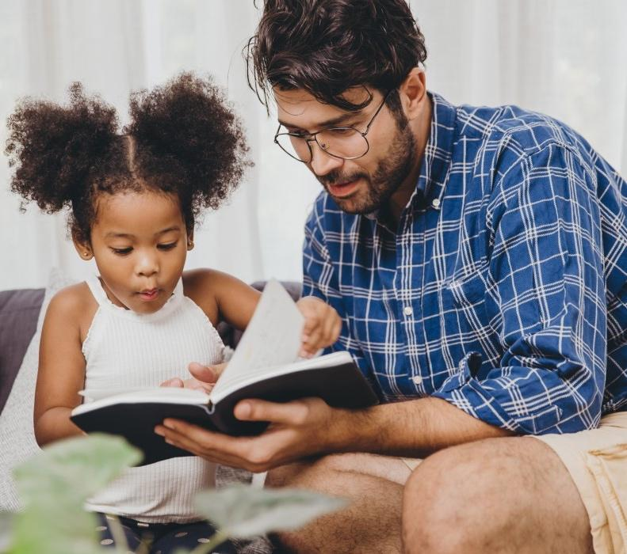
The most important thing you can do is read with your child
This will develop their…
Understanding of words and sentences
range of vocabulary
listening and comprehension skills
Notes:
Celebrate child’s success at school, make time for reading at home!

Slide 23
Listening to your child read their phonics book
Your child should be able to read their book without your help.
If they can’t read a word read it to them.
Talk about the book and celebrate their success.

Slide 24

Read to your child
The library book is for YOU to read:
Make the story sound as exciting as you can by changing your voice.
Talk with your child as much as you can
*Introduce new and exciting language
*Encourage your child to use new vocabulary
*Make up sentences together
*Find different words to use
*Describe things you see

Slide 25
Writing in Early Years
By the end of Early Years children are expected to:
Write recognisable letters, most of which are correctly formed.
Spell words by identifying sounds in them and representing the sounds with a letter or letters.
Write simple phrases and sentences that can be read by others.
Physical: Fine Motor
Hold a pencil effectively in preparation for fluent writing – using the tripod grip in almost all cases.

Slide 26
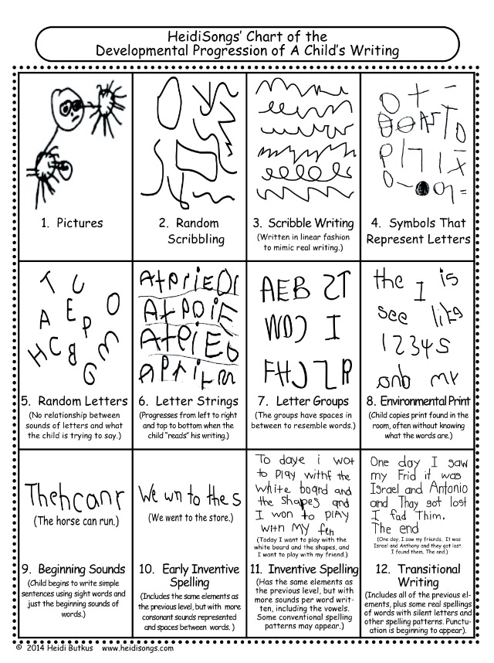
Stages of writing

Slide 27

Handwriting at South Farnborough Infants School
Pen Disco: This is a fun way to help the children develop their fine motor muscles and pen grip to support early mark-making. We start with a warm up to music using scarves and ribbons. The children follow movements to music which relate to the marks they will be making on the paper for that session. The children then pick up their choice of pen using crocodile fingers, we show them how to flip the pen so it rests in their hand ready for making the marks on paper to music.
Please take your child’s name card to take home and practice with your child. Please refer to the letter formation ditties to support your child with writing each letter in their name.

Slide 28


Book Club
Last year we started something called ‘Book Club’. This is where we choose a book and read it every day for a week during our carpet time. We talk about the story, make story maps and act out the story during the week and then on a Friday the children will draw or write anything they like in their pink books to do with this book.

Slide 29
in Early Years
This is what we are aiming for by the end of Early Years:
Number
Children will have a deep understanding of number to 10, including the composition of each number.
They can subitise (recognise quantities without counting) up to 5.
They can automatically recall (without reference to rhymes, counting or other aids) number bonds up to 5 (including subtraction facts) and some number bonds to 10, including double facts.
Numerical Patterns
Children can verbally count beyond 20, recognising the pattern of the counting system.
They can compare quantities up to 10 in different contexts, recognising when one quantity is greater than, less than or the same as the other quantity.
They explore and represent patterns within numbers up to 10, including evens and odds, double facts and how quantities can be distributed equally.

Slide 30
Number Time: We have number time sessions every day.
We follow a Maths scheme called Power Maths
How it works
Power maths is broken down into units which are then broken into daily logical steps. We use games, colourful graphics, videos and real world examples of maths in action to nurture an enjoyment of the subject at an early age. We let children explore mathematical concepts with curiosity and without a fear of making mistakes.

Slide 31
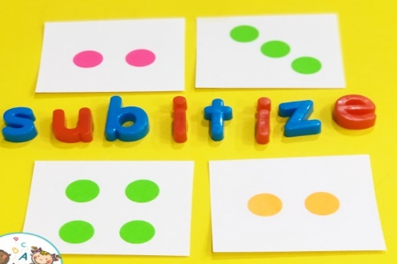
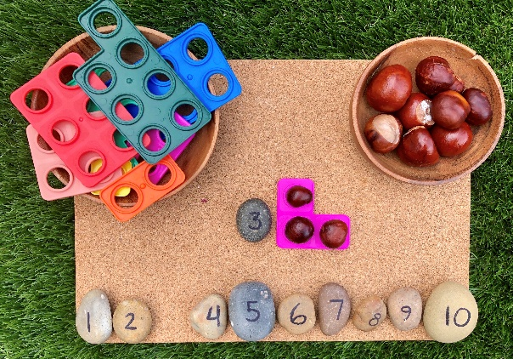
What we do in Number Time
We work practically in our maths sessions – it is more important to be able to count the correct amount of objects up to 10, than to be able to chant numbers up to 20, 30, 40, 50 …
Subitising – What does it mean?
Subitising is the ability to instantly recognize the amount of objects without actually counting them.
Numicon - We use numicon a lot in Early Years. Numicon is an effective learning tool for helping children visualise numbers.

Slide 32
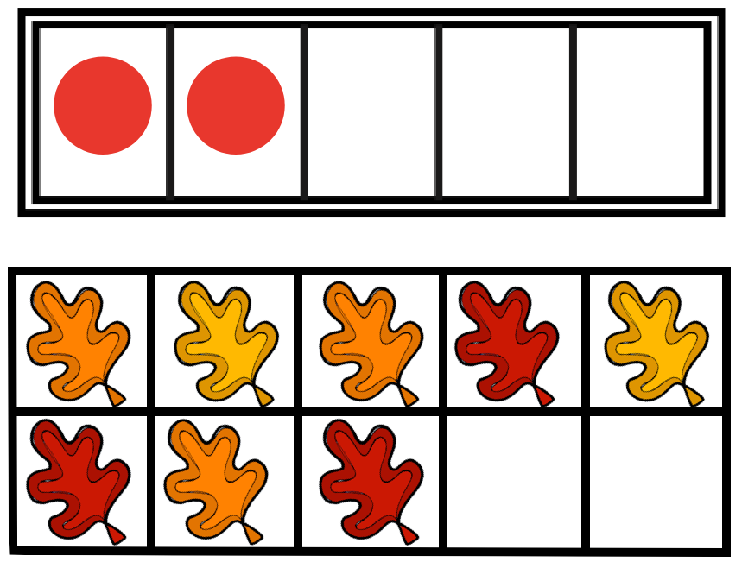
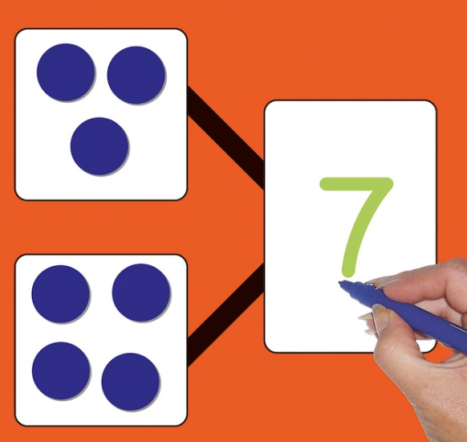
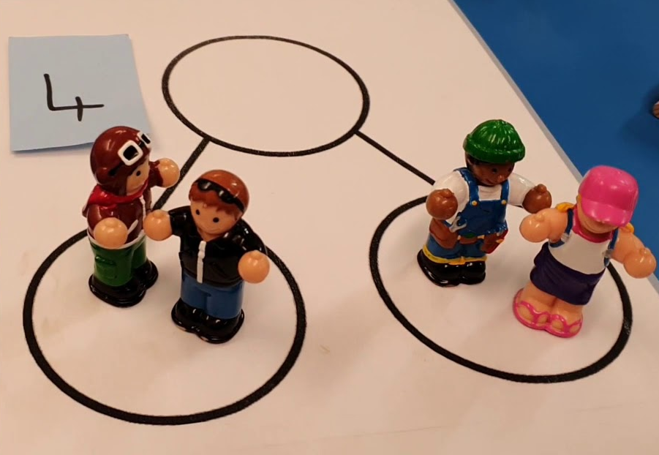
Five and Ten Frames Five frames and ten frames allow you to “see” a number. It helps to develop a strong sense of five and ten. It strengthens the way children think about and talk about numbers and number combinations.
Part, part, whole Part-part-whole reasoning also helps children to interpret, visualize, and solve word problems.

Slide 33

Tapestry is award-winning software with tools to help educators work in partnership with families, document children's learning and development, and develop a child-centred approach to planning and assessment.
Each child has their own online learning journal on Tapestry. This journal enables us to follow your child's learning and development, and to plan experiences to help them to make progress. Through the journal we will share wow moments of learning with you, which can be words or pictures about your child's time here. You will also be able to use Tapestry to add pictures and videos of learning and experiences that happen at home. These will help us to get to know your child better - getting to know each child is at the heart of our good practice.
Please note that whilst home and school will be able to comment on observations, Tapestry is not a direct messaging service to staff, so please do continue to liaise with teachers in person or via the school office.

Slide 34
Newsletters
The Reception Newsletter is written each half term to give you:
Information about what the children have been learning about during the half term.
Interesting things that may have happened during the term.
Ideas for you to do with your child at home to support their learning and development.
Important information about things that may be coming up or things that will support us as teachers to make classroom life easier.
Dates for your diaries.
It is emailed to you each half term but it is also available on our new school website
https://www.southfarnborough-inf.hants.sch.uk/reception

Slide 35


Thank you for coming this evening.
We hope you have found this information helpful in supporting your child through their first year at school.
Any questions?

