Slide 1



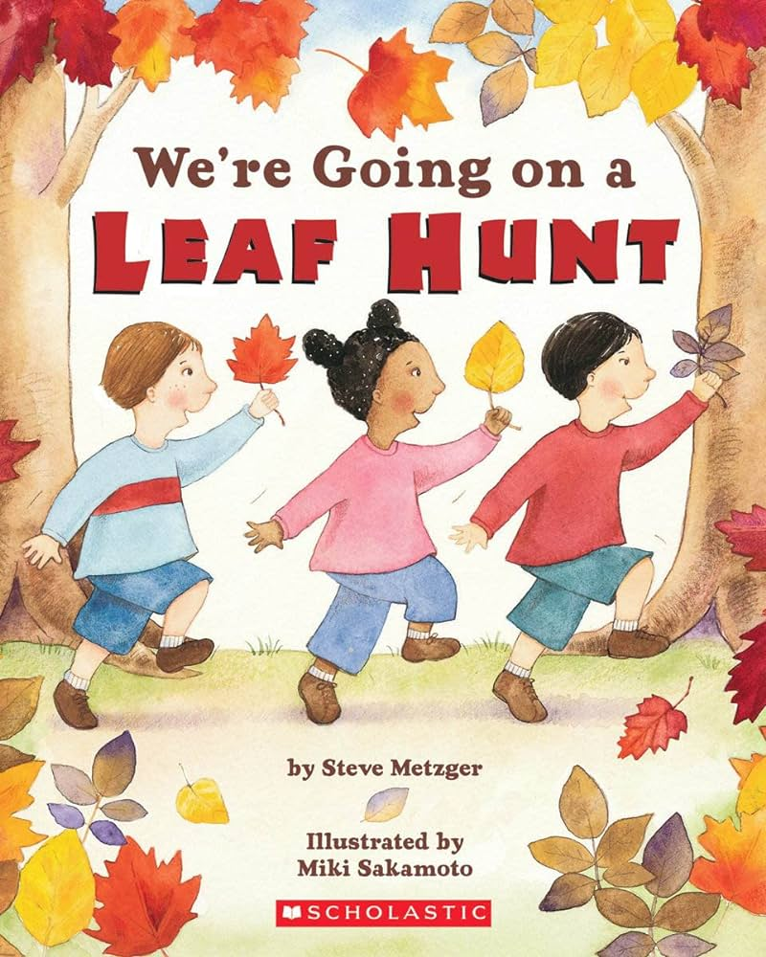

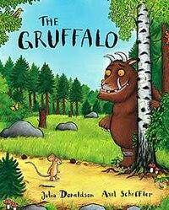
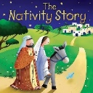
Reception Newsletter
Autumn 2
Reception News
Autumn 2 Topics
Autumn: We have started this term with our book club book ‘We’re Going on a Leaf Hunt’ which led to us going on an Autumn walk around the school grounds, collecting leaves and looking for signs of Autumn. We have also started making leaves out of clay.
This week our book club book will be ‘Leaf Man by Lois Ehlert. The children will be making their own leaf pictures and doing lots of other leaf activities including leaf rubbings, paintings and continuing to make their clay leaves which they will then paint.
We will then move on to the well loved book ‘The Gruffalo’ by Julia Donaldson. We will use this book to look at animals and to group them by different types as well as talking about whether they are Nocturnal or Diurnal. We will then move on to looking at the different environments in the book and we will compare these looking for similarities and differences.
At the end of this term we will then move on to Christmas and the Nativity. We will talk about why we celebrate Christmas and tell the Nativity story. The children will be learning songs, actions and words to enable them to put on our Nativity performance for you to come and watch!
We are so pleased with how all the children have settled down into school life! They are used to the routines and are always excited to come in to the classrooms and look at our visual timetable to see what they will be doing that day. Autumn 2 is always a busy term in the run up to Christmas but it is an exciting term too and we have so much planned for the children!
Phonics and Number Time
In phonics this term the children will learn the rest of the phase 2 phonemes which include the single sounds j, v, w, x, y, z and the digraphs ss, ll, ff, zz, qu, ch, sh, th, ng and nk. We will be looking at words with a ‘s’ on the end and learning quite a few more tricky words.
In Number Time this term we will be following our ‘Power Maths Planning’ and completing units on 2D shapes, change within 5, number bonds within 5 and spatial awareness.

Slide 2

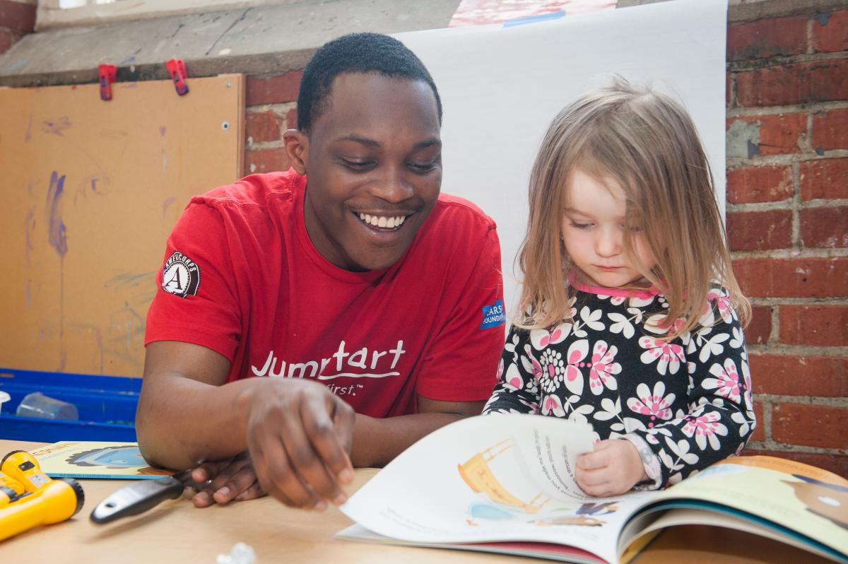
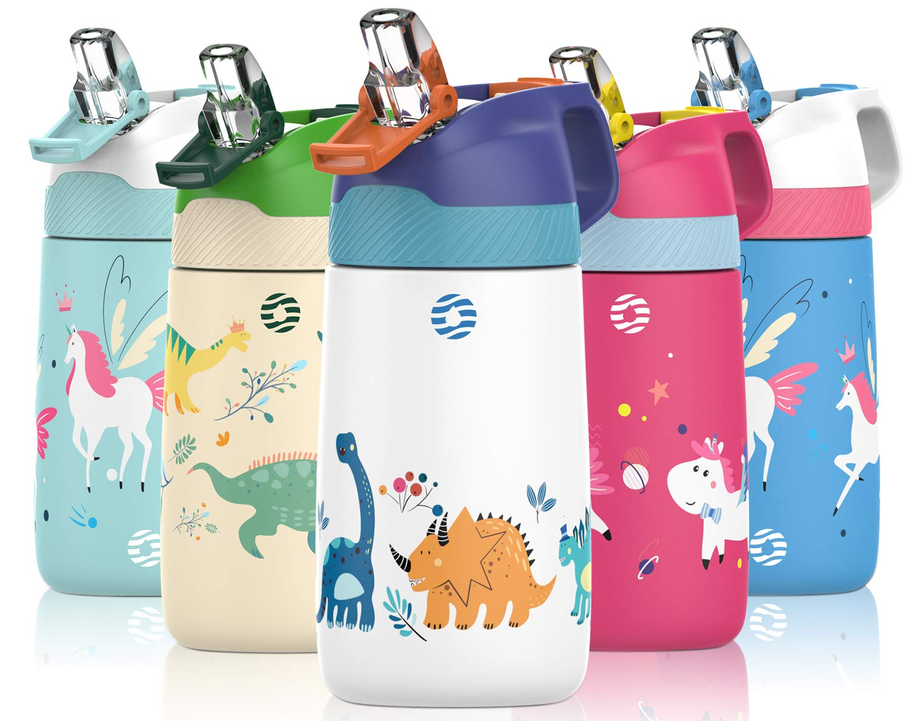
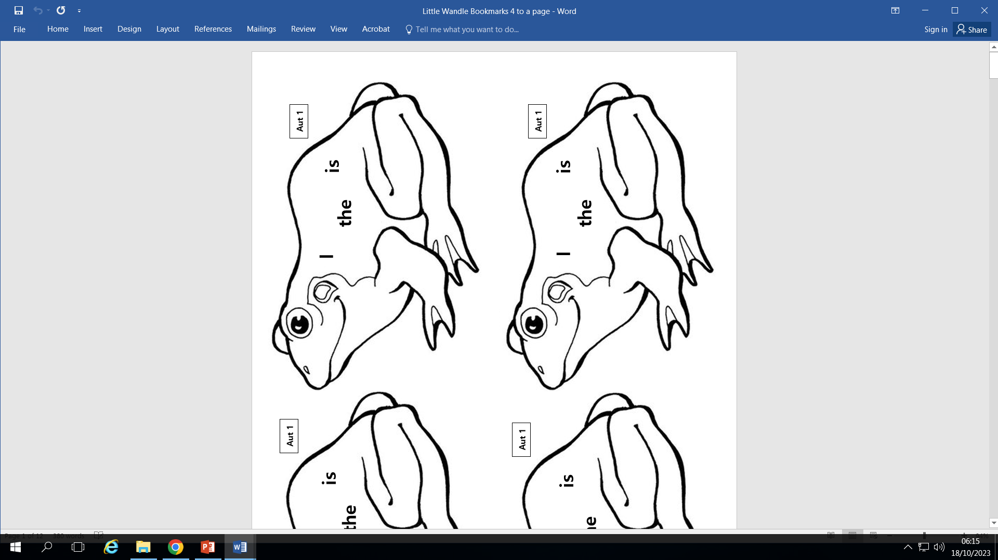
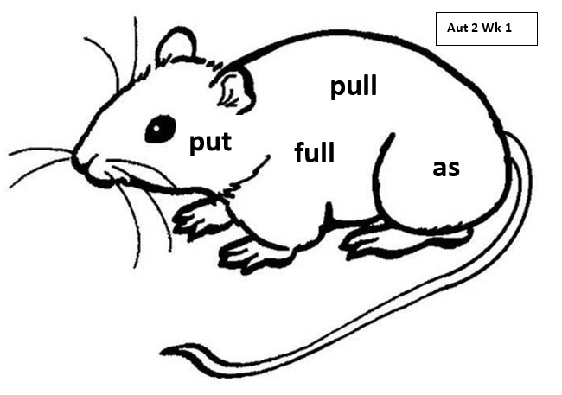
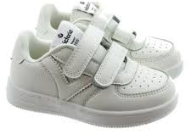
Reading
Your child is bringing home a reading book every Friday from our Little Wandle Phonics scheme. Some children will have wordless books as they are not quite there with their blending yet whilst others will have words. Please ensure you encourage your child to read to you at least once over the weekend and use the inside front and back cover to help you with ideas and questions to ask.
How to Help at Home
Important information
Parent Information Evening – If you didn’t manage to attend our parent information evening or you just want to check what was said then please head to our website using the link below to find the power point for the meeting. https://www.southfarnborough-inf.hants.sch.uk/reception
Please do not put your child’s water bottle in
their book bag as they often leak and then they
ruin any school library or reading books.
Please make sure that everything your child
wears and brings to school is clearly named with
their first and last name.
Please ensure your child wears Velcro fastening
trainers to school everyday as these are the best
footwear for running and climbing
Please check book bags regularly for any important information and to empty out any pictures or models your child has done at school.
Cut up and practise the sounds sent home, you could hide them round the house to find and say or stick them to doors or cupboards and your child has to say them every time they open the door.
Practise the tricky words on the frog and mouse animal bookmark. Remember these are tricky words and cannot be sounded out. See if your child can find the words in other places around the house or when out and about.
Make sets of objects up to 5 and get your child to count them accurately. They could lay the table counting how many knives and forks they need.
Can they tell you what one more or one less is from a group of objects up to 5?

