Slide 1






Reception Newsletter
Spring 1
Reception News
Spring 1 Topics
Harmony:
Walking Through The Jungle:
Handa’s Surprise:
RE - Jesus as a Storyteller:
It was lovely to see all the children back to school on Tuesday, excited to tell us about their Christmas and ready to get back into the school routine. We have enjoyed looking at the children’s scrap books. If you haven’t returned yours yet please bring in as soon as possible.
During the first two weeks of the Spring term the children will be learning about our 7 Principles of Harmony. We will be learning the names, a special hand gesture for each one and what each principle means. The children will find out about how they all fit together and why they are so important in our World.
We will then move on to our Jungle topic which explores different jungle animals and focuses on our book club book ‘Walking Through the Jungle’ by Julie Lacombe.
Phonics and Number Time
In phonics this term the children will learning the phase 3 digraphs and trigraphs:
ai, ee, igh, oa, oo, oo, ar, or, ur,
ow, oi, ear, air & er.
In Number Time this term we will be following Power Maths and will look at numbers 6, 7, 8, 9 and 10. We will then compare numbers within 10 and look at adding numbers to 10. We will finish the half term with a unit on measure.
Our book club book will then be Handa’s Surprise by Eileen Brown. We will look at our Harmony Principle of Diversity by discusing what’s the same and different about Handa and her life with our lives.
We will finish this half term with our RE topic by looking at Jesus and the stories he told.

Slide 2

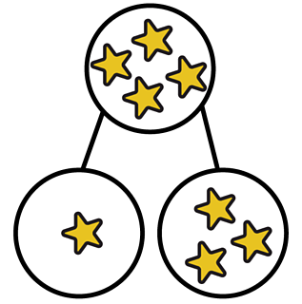
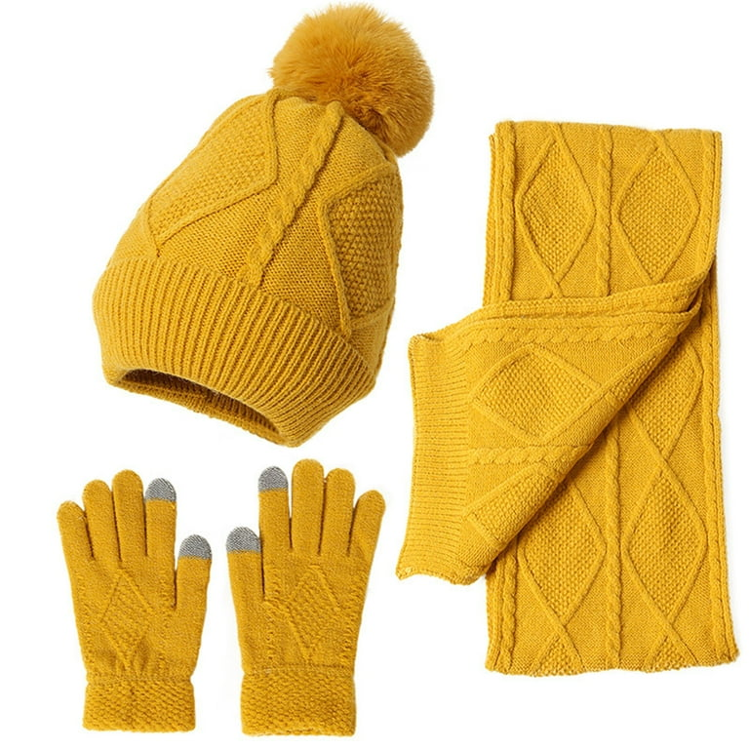
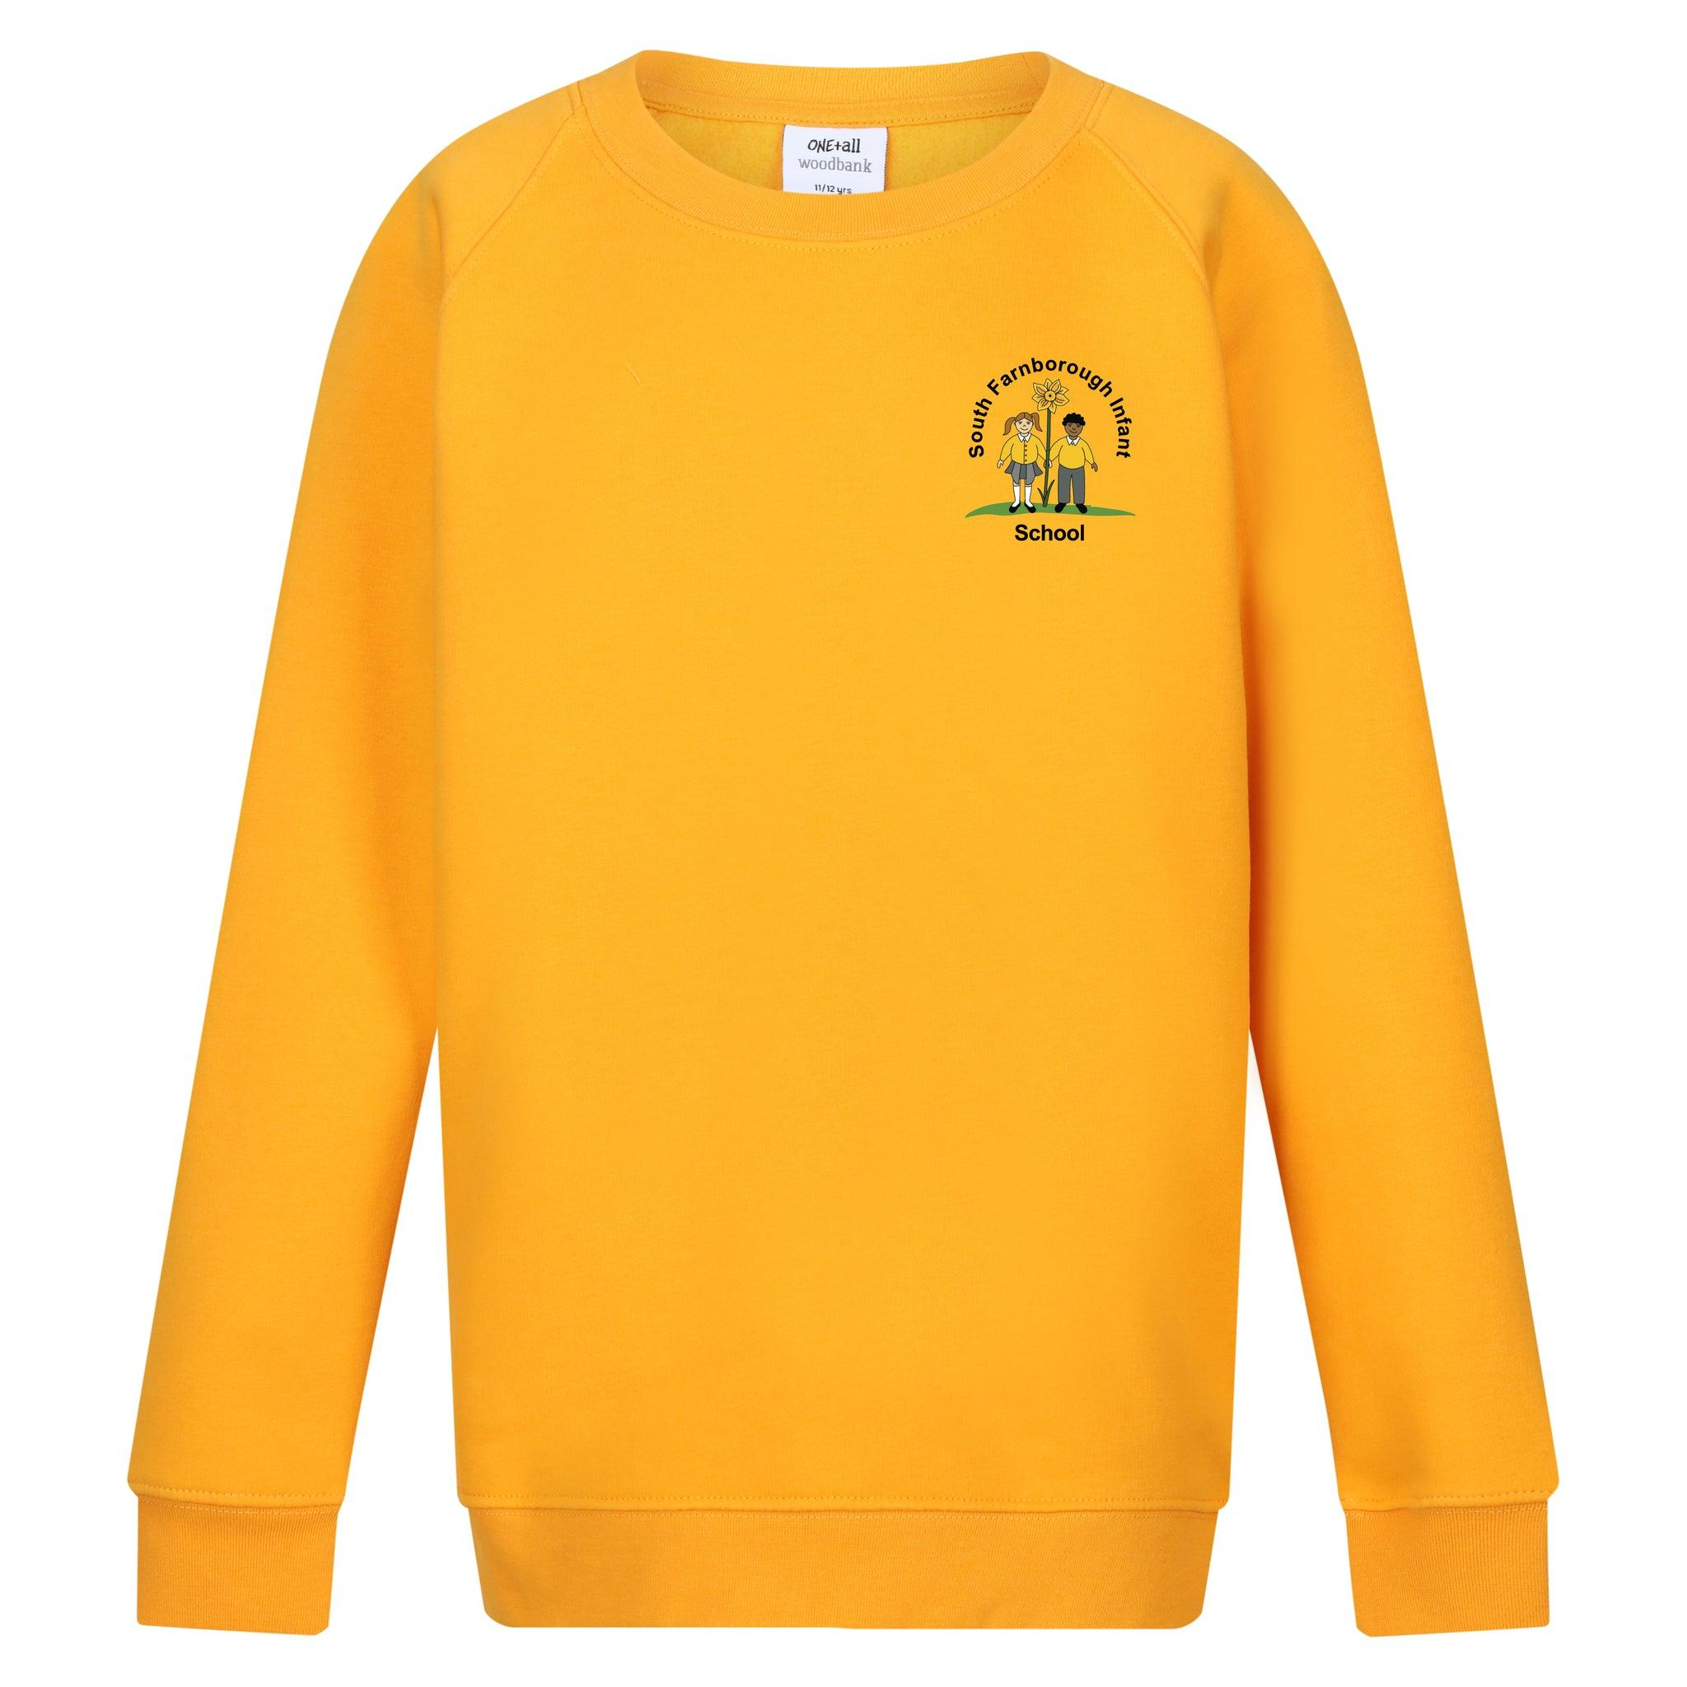
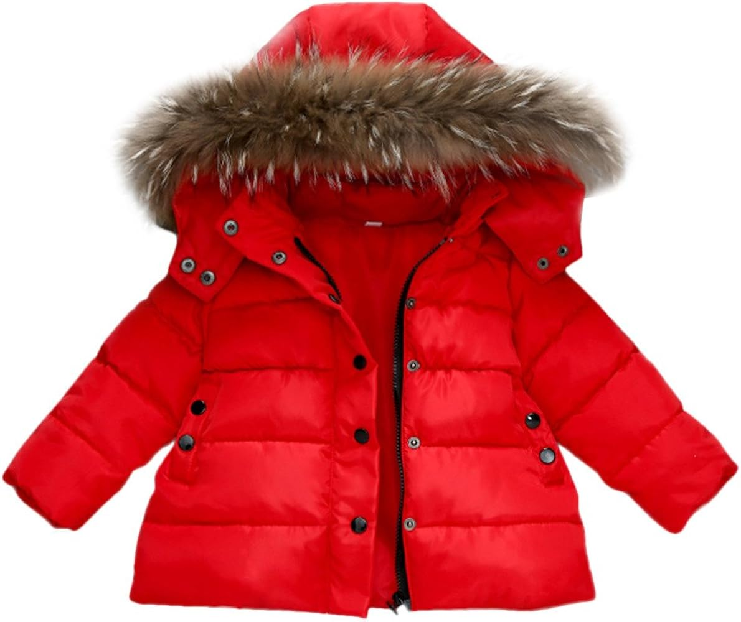
Reading
We are so proud of how well the children are doing with their reading, we hope you are too! Please try to read with your child at least once each weekend using the information in the front and back cover of the book to support your child to read their book at home. They will have read this book two or three times at school so they should be quite confident by the time they read it to you. Encourage them to find and read any tricky words as well as to sound out new words that can be sounded out.
How to Help at Home
Important information
Cut up and practise the new digraphs and trigraphs sent home each week. You could hide them round the house to find and say or stick them to doors or cupboards and your child has to say them every time they open the door.
Practise the tricky words on all the animal bookmarks so far. Remember these are tricky words and cannot be sounded out. See if your child can find the words in other places around the house or when out and about.
Practise making numbers to 5 then try other numbers such as 6, 7, etc. in different ways using objects around the house. You could draw a part, part, whole grid l like the ones we use at school
Please ensure that your child is not wearing jewellery or watches on our PE days (Wednesday’s or Thursday’s) unless it’s for medical or religious reasons.
Please don’t let your children play on the outside equipment before or after school, we are not insured if your child has an accident.
Please make sure that absolutely everything is named including hats, scarves and gloves.

Slide 3

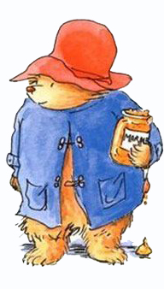
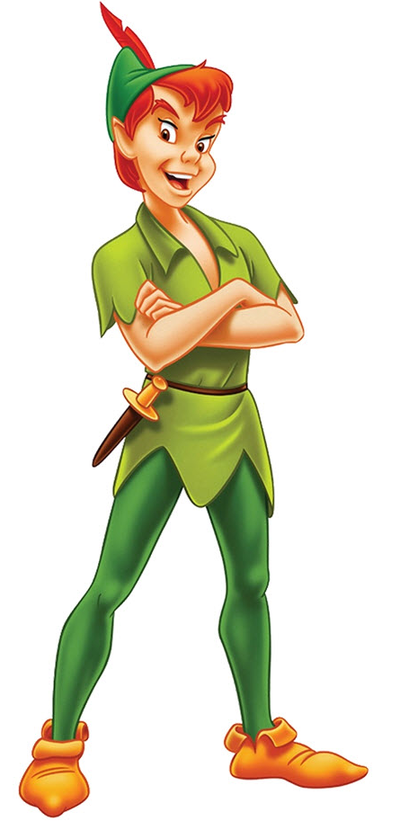
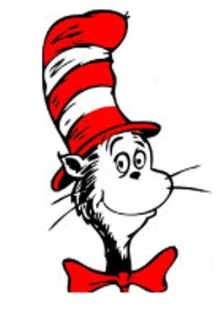

World Book Day 2026
Thursday 5th March
We are excited to celebrate World Book Day with our theme “Read Your Way”. This year, we are encouraging children to enjoy stories in any form they love. This could be; traditional books, comics, magazines, audiobooks, or graphic novels. All reading counts!
To mark the occasion, children are invited to come to school dressed as a character from their favourite story.
As part of this activity, we will also be encouraging children to explore and use rich, ambitious vocabulary— adjectives they might not use in their everyday conversations. This is a wonderful way to deepen their language skills and help them describe characters with more precision and creativity. Therefore, along with their costume, we ask each child to choose an adjective that describes their chosen character. This word should be displayed somewhere on their outfit in the form of a badge/ sticky label For example, a superhero might choose brave, or a fairy-tale character might choose kind or curious.
We look forward to celebrating the joy of reading together and seeing all the wonderful costumes and descriptive words the children choose
Please join us in school at 2.30pm on Thursday 5th March to read and share stories with your child in school.

