Slide 1
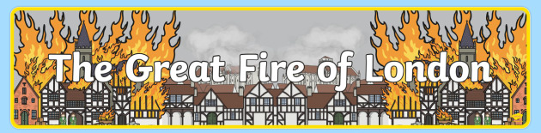

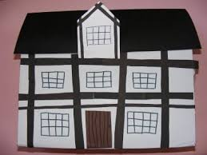
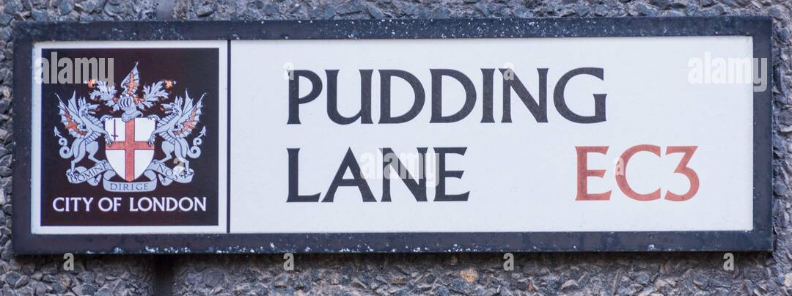
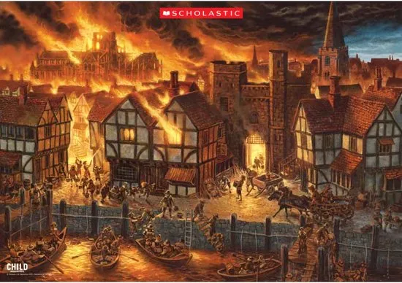
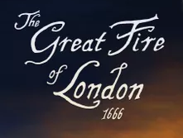
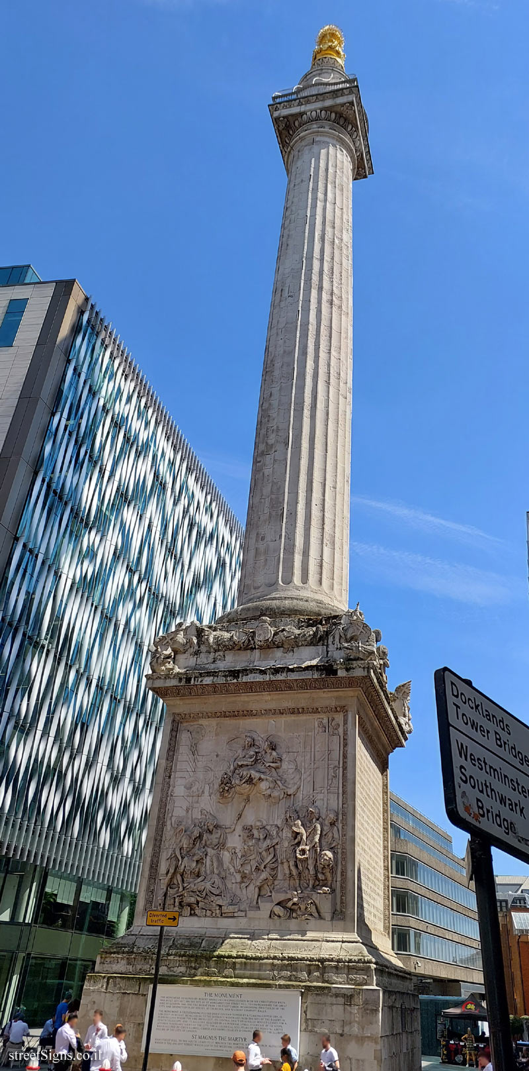
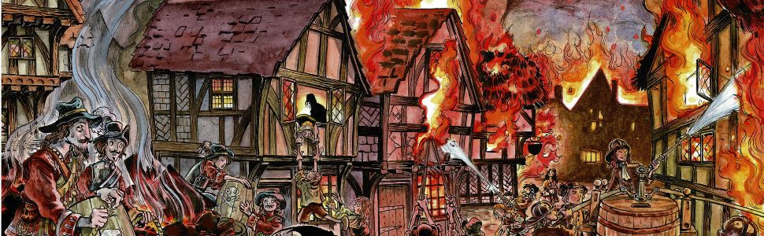
Thank you to those of you who joined us for our Christmas Crafts event in school before the holidays. The children had a blast and were proud to show you into their classrooms and make some special keepsakes alongside you.
Resources needed: Please send your children into school with a cereal box. We will be using these to make our own Tudor Houses over the course of the half term.
What are we learning?
What can we learn about Diversity and Adaptation from The Great Fire of London?
This half term we will be learning all about The Great Fire of London. We will think about life during the 17th century and how it differs from the lives we lead today. Throughout the half term we will draw upon our knowledge of London and think about how the design of London in 1666 contributed to the fire. Alongside this, we will learn about fire safety and how to keep ourselves and others safe.
Class Assemblies
We will be doing class assemblies this half term that will take place in the school hall from 2.30pm.
Swifts- Monday 10th February
Robins- Thursday 13th February
Skylarks- Friday 14th February
Please arrive in the front playground ready to be let in 5 minutes before the assembly starts.

Slide 2


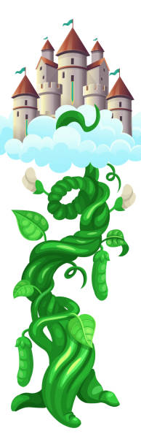
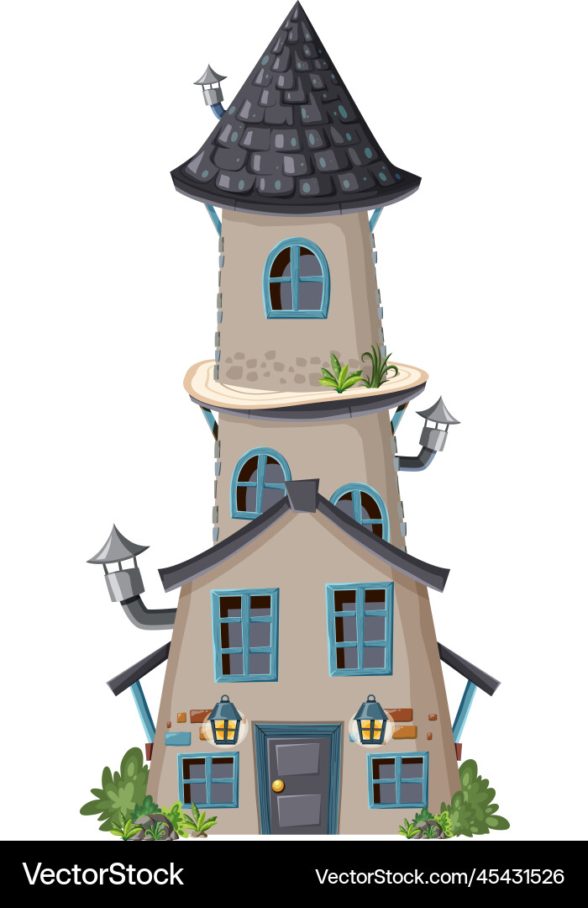
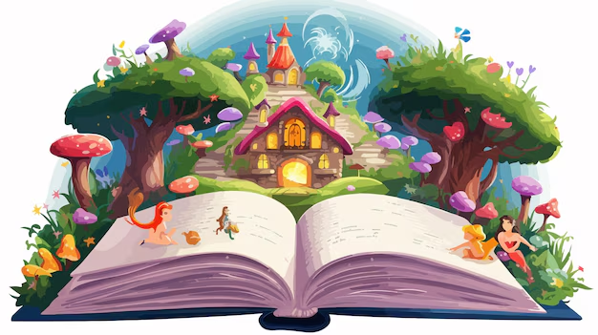
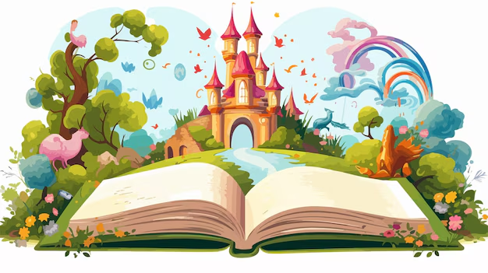
World Book Day 2025
Thursday 6th March
For world book day this year we will be celebrating Fairy Tales. We would like to invite all children to come to school dressed as a character from their favourite fairy tale story. In school, each class will complete a range of activities on a chosen book and share our love of stories together. In line with our Harmony Curriculum we would prefer families to reuse/adapt items of clothing you already have to avoid waste and expense.
Please join us in school at 2.30pm on Thursday 6th March to read and share stories with your child in school.

